Slide 1
AN INTERACTIVE SEMINAR FOR SENIORS AND THEIR FAMILY TIES

Slide 2
THE BEGINNING
OF THE NINTH INNING

Slide 3
INTRODUCTION
We are thankful to the Lord for our blessed life with
Family, Friends, and Church Family. We’re grateful to our parents. We’re enjoying the fruit of their sacrifice in enabling our successes and blessed children and grandchildren.
We’re now looking at the bottom of the 8th Inning or the beginning of 9th Inning of our lives. We’re thinking about the “pitches” and “at bats” in the Last Inning/s of our Lives.

Slide 4
SHARE TIME: Chose one or both, if you like:
Looking back these past two years, share the highs and lows of those years?
Looking ahead in the next three years, share the challenges you foresee ahead of you?

Slide 5
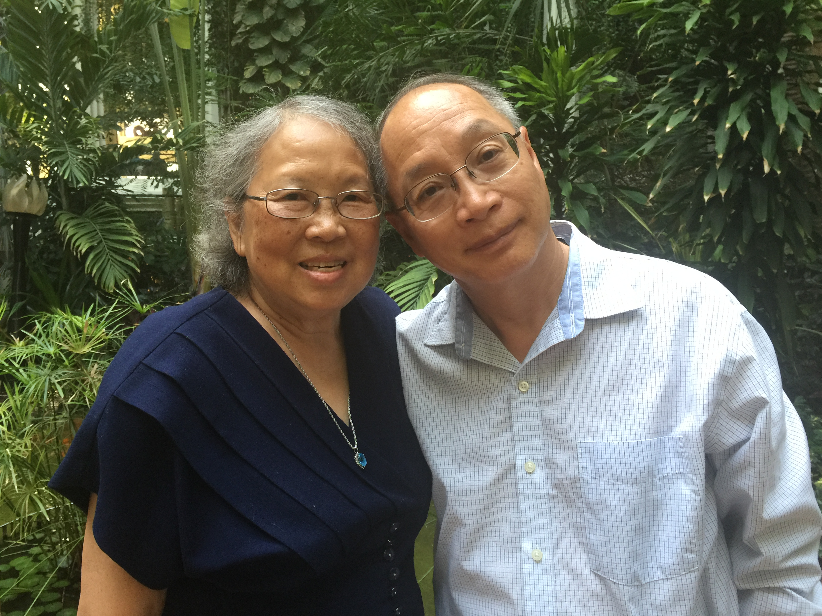
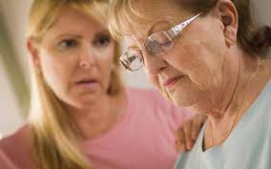
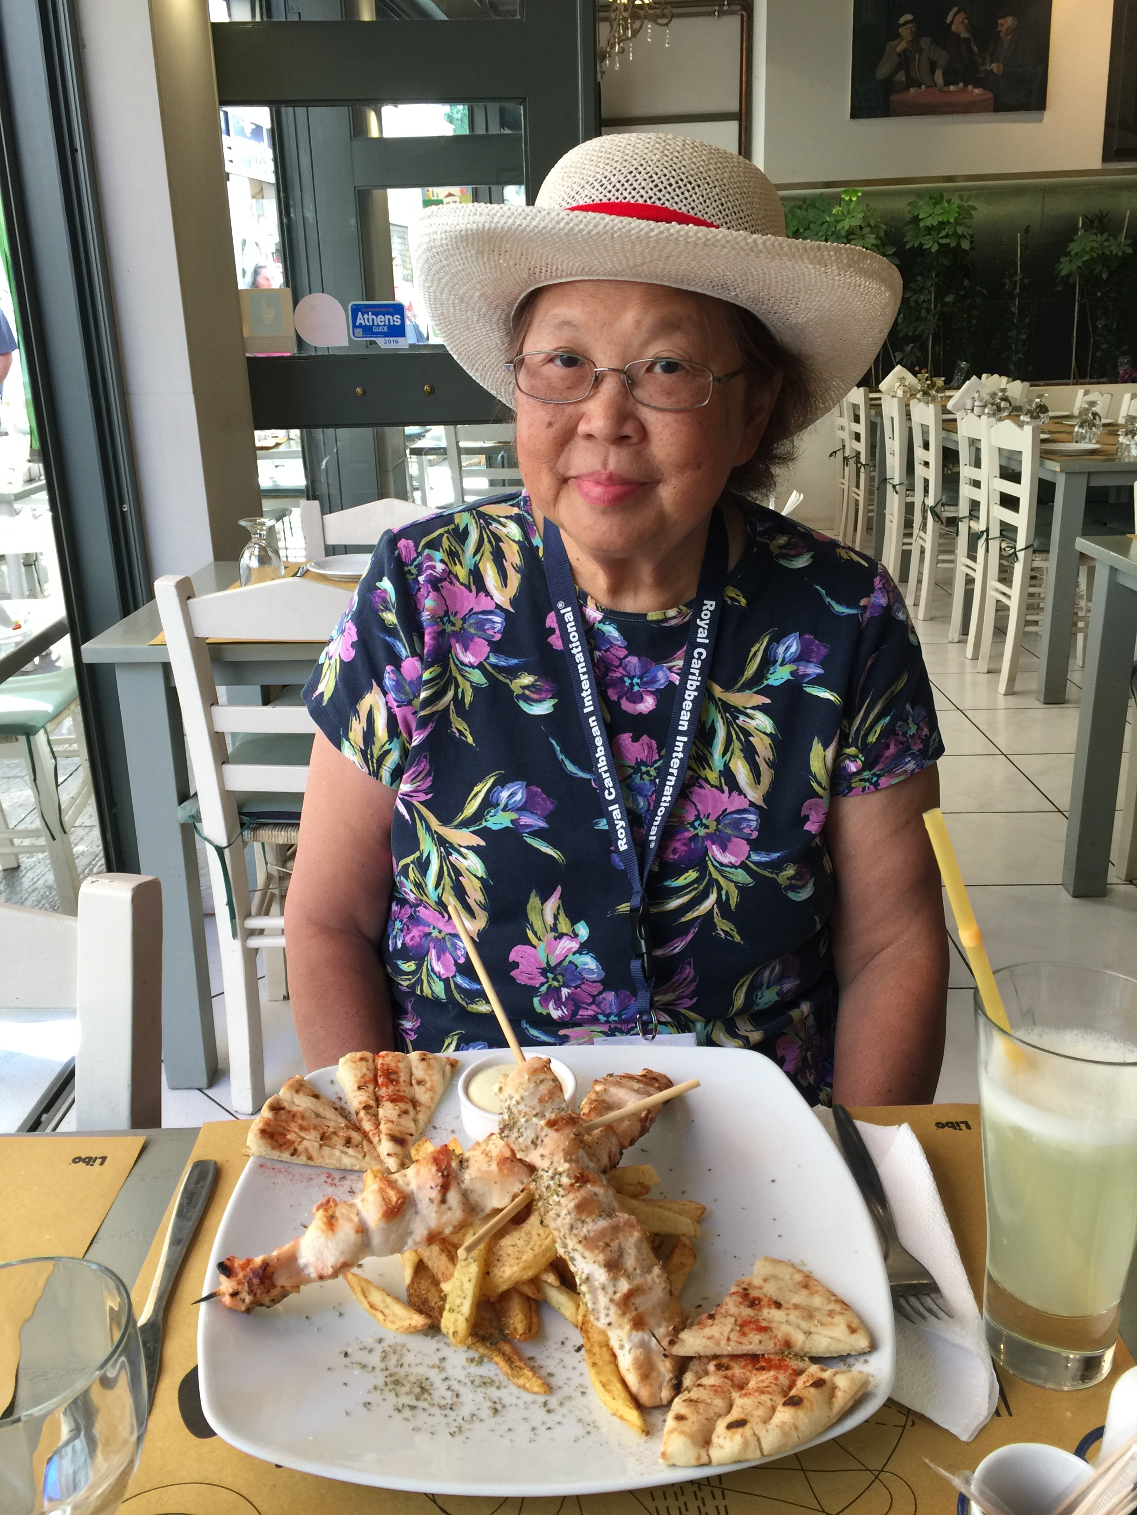
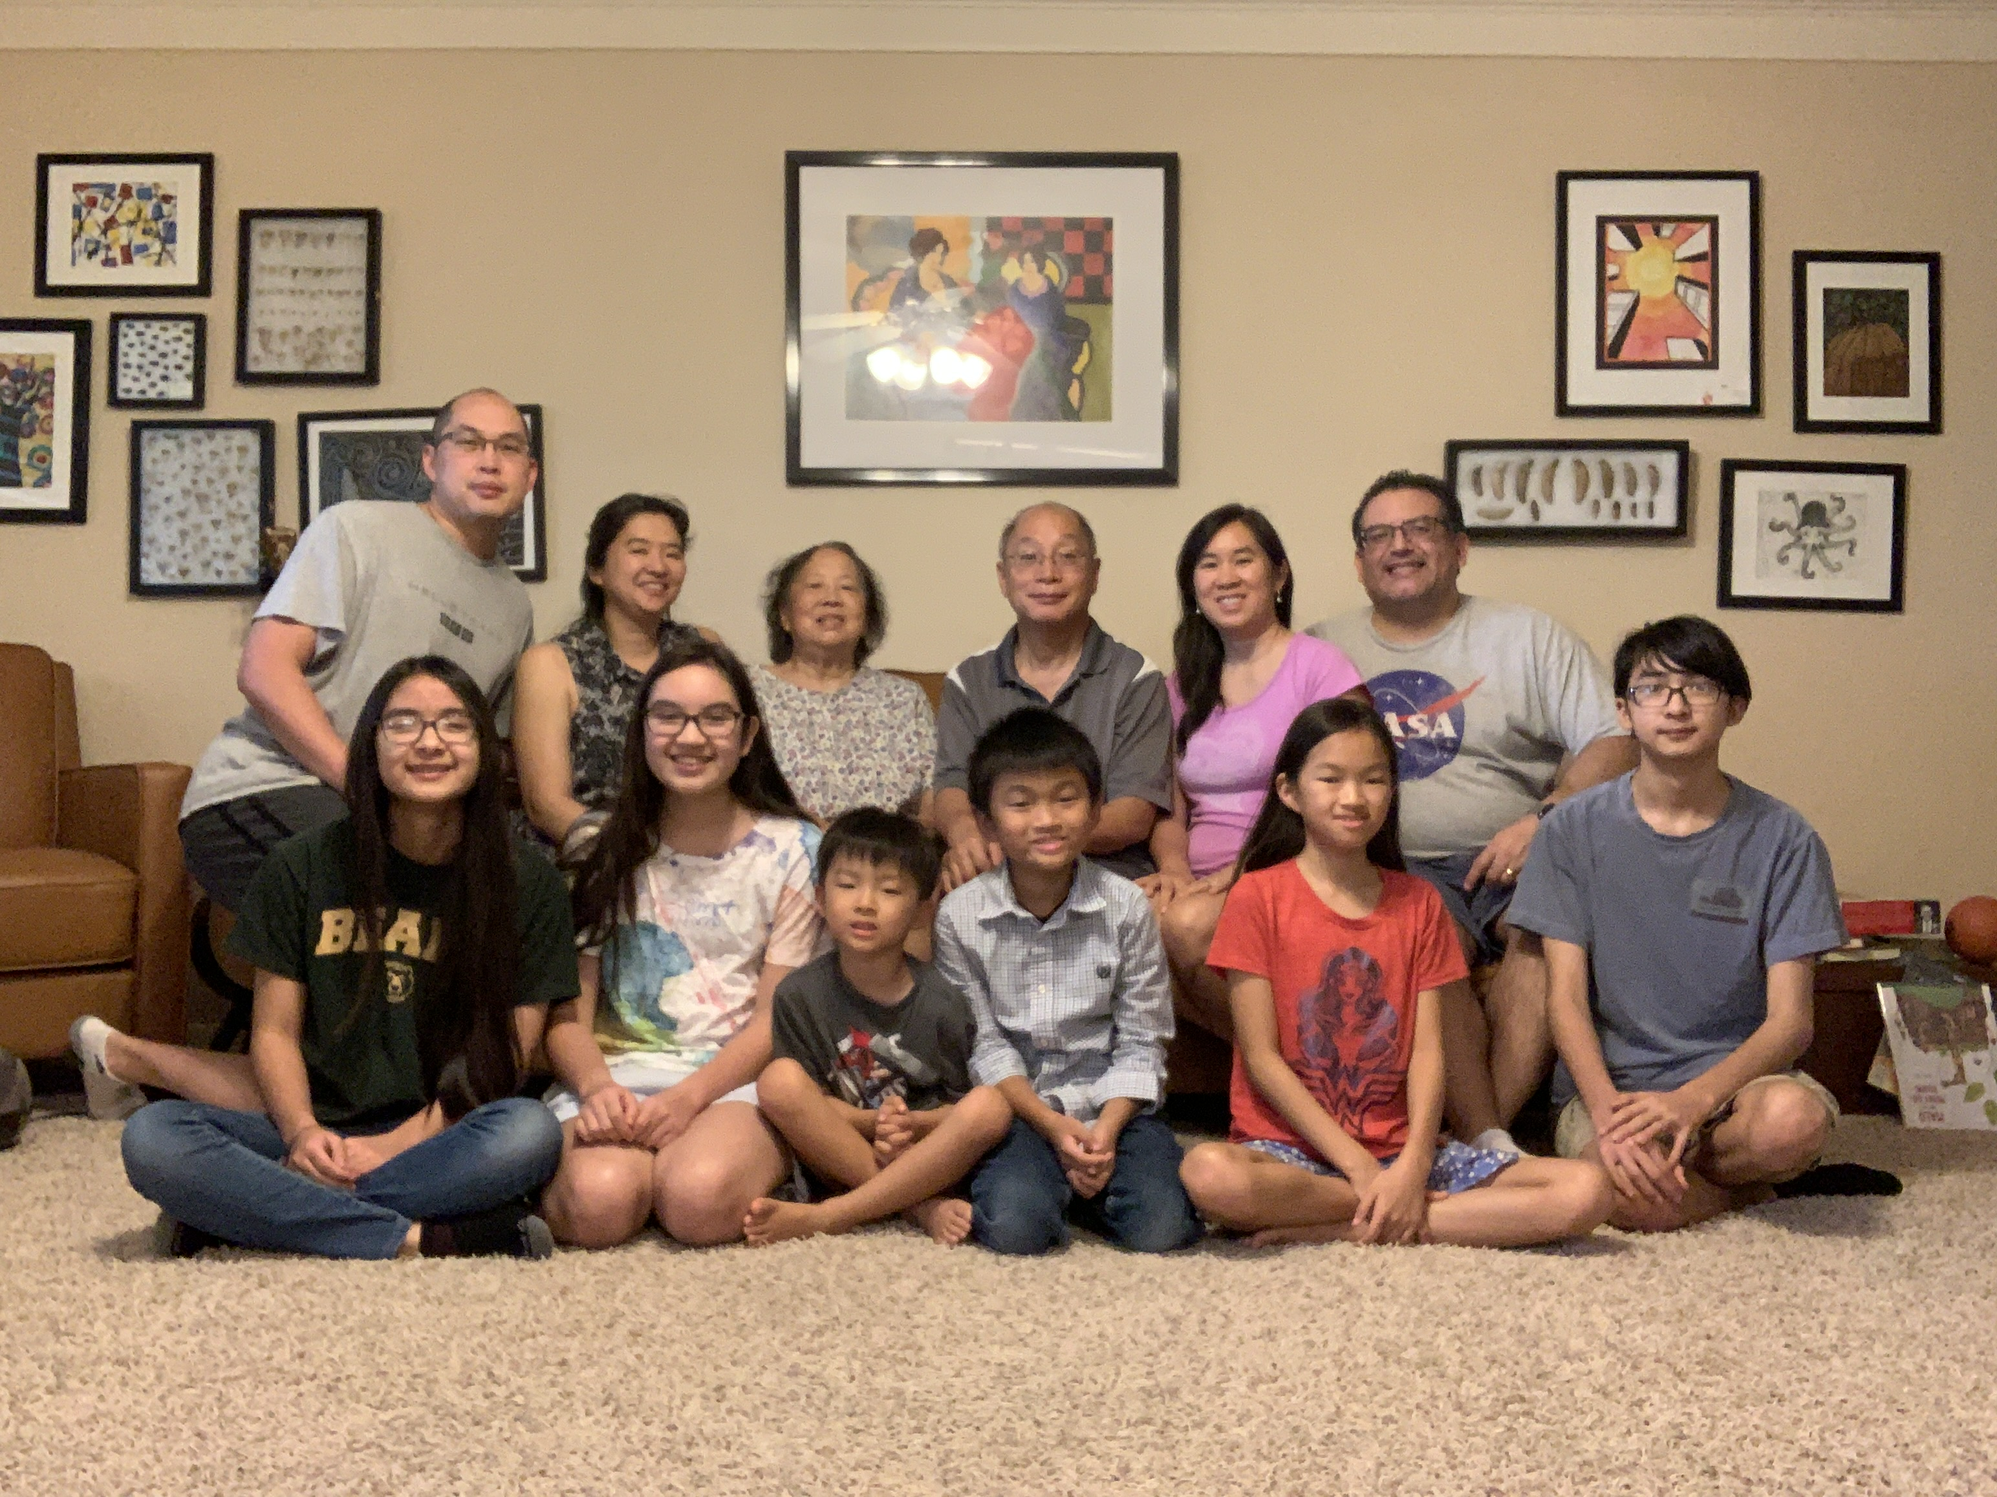
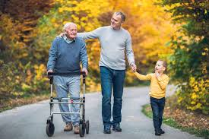
I. THE DREAMS AND DREADS IN RETIREMENT.

Slide 6
WHICH STATEMENT DESCRIBES YOU BEST RIGHT NOW:
1. “MY DREAM YEARS ARE COMING TRUE AND I/WE
ARE ENJOYING IT EACH DAY!”
2. “MY DREAM YEARS ARE BECOMING MORE LIKE
MY/OUR WORST NIGHTMARE!”
3. “I’M NUMBED AND I DON’T DREAM ANY MORE!”

Slide 7
A. LIST OF CHALLENGES IN OUR RETIREMENT:
□ Our DECREASING HEALTH
□ Our INCREASING PROSPECT of Assistant Living
□ Our LIMITING LIFESTYLE by Helping Extended Families
□ Our INCREASING CONCERNS for our Children and
Grandchildren’s Lifestyle and their Education.
□ Our WONDERING of our Purpose in Life
□ Our DECREASING FRIENDS and FELLOWSHIPS due
to Age or Disabilities
□ Our FACING of our Spouse/Self in Life Ending Issues.

Slide 8
APPLICATION: WHAT’S REALLY BOTHERING YOU?
LIST THE TOP THREE CHALLENGES OR STRUGGLES THAT YOU
OR YOUR SPOUSE ARE FACING TOGETHER:
1. ______________________________________________
2. ______________________________________________
3. ______________________________________________
REMEMBER: Always SPEAK the Truth in Love

Slide 9
B. ASSESSING OUR FEELINGS.
► My Dominant Feeling is
______________________
► My Dominant Feelings
Regarding Other Family
Members are
_______________________
:
9

Slide 10
CENTRAL THOUGHT:
“YOU CAN’T MOVE FORWARD
UNTIL YOU RESOLVE THE PAST.
“Leave your gift there before the
altar, and go your way. First be
reconciled to your brother, and
then come and offer your gift”
(Matthew 5:24).

Slide 11
OUR INTERACTIVE TOPICS:
I. FACING THE DEMANDS OF FAMILY MEMBERS
II. FACING THE DIMINISHING SPIRITUAL INFLUENCE OVER
OUR FAMILY MEMBERS
III. FACING THE DREADED DAY IN OUR OWN LIVES

Slide 12
I. DISCUSSION AND EXPLORATION:
FACING THE DEMANDS OF FAMILY MEMBERS
(THE TYRANNY OF THE CELL PHONE)

Slide 13
My son tells me, “Dad, Don’t turn off your cell phone and carry your cell phone with you all the time! There could be an emergency and I can’t reach you!”
When it pings, I feel like I have to read the text message. When it rings, I have to see if it is a number I recognize before I answer it. I check my emails on it and read the news while I am shopping with Ramona.
To be honest, my life revolves around the cell phone. It’s the cell phone which controls my life. It’s the TYRANNY of the Cell Phone Caller!

Slide 14
Scenario: Text Message Waiting as You Turn On Your IPhone:
“Mom, Jack and I are going to Sausalito for the day. We’re dropping the kids off at 9:00. I know it is the last minute, but I hope you don’t mind. We’ll be back before dinner, I think. Love You.” (It’s Saturday morning.)
The problem is that both of you were planning to have brunch at the Cliff House and a relaxing day at the Botanical Garden. They have a 2 year old and a 4 year child. What are you going to say to them or do that day?
S

Slide 15
I. THE ATTITUDES TOWARDS SENIORS.
A. Prevalent Attitude of Family/Church Members Toward Us.
• Lots of FREE TIME.
• NOTHING IMPORTANT to do all day.
• NOTHING BETTER to do than to HELP us!
• Your help SAVES us TIME and MONEY.
• You’re RICHER and you can AFFORD it!
• You have MORE EXPERIENCE so you do it!
• You’re LOVING if you say, “YES” to us!

Slide 16
Prevalent Attitude Toward Self or Others.
• It’s UNLOVING to say “NO” to a Request.
• It’s more BLESSED to Give than to Receive.
• It’s being the GOOD SAMARITAN.
• It’s being a POSITIVE ROLE MODEL of Serving.
• It’s having a SERVANT’S HEART like Jesus.
• It’s AVOIDING being called, “SELFISH“.
• It’s want Grandparents Supposedly to DO for Them.
“YOU’RE TO BE AVAILABLE TO US 24/7, 7 DAYS A WEEK,
50 WEEKS IN A YEAR EXCEPT FOR 2 WEEKS VACATION!”

Slide 17
C. The Headaches and Heartaches of Seniors.
• We feel our KINDNESS is being TAKEN ADVANTAGE OF by
Others.
• We receive FEW SINCERE THANKS from Others.
• We feel that we DON’T HAVE TIME for Ourselves.
• We feel that we HAVE GIVEN ENOUGH to Them.
• We receive HARDLY ANY REIMBURSEMEN from Them.
• We don’t Understand WHY Others Don’t Help More.
Are you BECOMING more BITTER as the days go by?

Slide 18
THE DISCUSSION AND DECISION:
Before the door bell rings, what will you say to each
other? How would you feel? Will you change your plans or ask them to change their plans?
Remember the text message: “Mom, Jack and I are going to Sausalito for the day. We’re dropping the kids off at 9:00. I know it is the last minute, but I hope you don’t mind. We’ll be back before dinner, I think. Love You.”
What Biblical Principles would you apply to that situation?
S

Slide 19
THREE BASIC KEY PRINCIPLES for One’s Consideration:
1. Take a MOMENT to Pray by asking for Wisdom from
God (James 1:2-7).
2. Make a FAITH BASED DECISION on your understanding
of God’s Will (Romans 12:1-2).
3. Look for SPIRITUAL IMPACT OPPORTUNITIES in the
time spent with others (Matthew 28:18-20).
RESULT: FINDING GREATER JOY AND PEACE IN SEEING THE
SPIRIT OF GOD WORK IN AND THROUGH YOU.

Slide 20
SETTING APPROPRIATE BOUNDARIES.
1. DETERMINE the Amount of Days to “Help” Babysit in
a Week and the Hours.
2. DETERMINE what Compensation you want for Food
and Gas. Compensation can be Money or Dinner.
3. DETERMINE what Parents to Bring when the kids
come over.
4. DETERMINE the Advance Notice Require unless for
sickness (emergencies).
5. STATE your Vacation Days in Advance to them.
6. NEGOTIATE with your Children and or In-Laws.

Slide 21
SUMMARY:
ESTABLISHING HEALTHY BOUNDARIES PROVIDE QUALITY OF LIFE FOR YOURSELVES AND DEVELOPS PARENTING RESPONSIBILITIES FOR YOUR CHILDREN.
The Parents are to TRAIN UP their Child in the Way, s/he should go, not the Grandparents (Prov. 22:6).
Parents are to HONOR their Father and Mother, not abuse them by overusing them (Exod. 20:12).

Slide 22
II. DISCUSSION AND EXPLORATION:
FACING THE DIMINISHING INFLUENCE
OVER OUR (ADULT) CHILDREN
(THE RE-INVESTMENTS OF OUR LIVES)

Slide 23
WHAT’S HAPPENING TO THE
NEXT GENERATION OF CHRISTIANS?
HERE YESTERDAY, MISSING TODAY, AND GONE TOMORROW?

Slide 24
I. BARNA REPORTS:
The percentage of young-adult dropouts has increased from 59 to 64 percent. Nearly two-thirds of U.S. 18–29-year-olds who grew up in church tell Barna they have withdrawn from church involvement as an adult after having been active as a child or teen.

Slide 25
II. SHARE TIME: CHOSE ONE OR BOTH QUESTIONS.
A. WHY DO YOU THINK ARE THE REASONS/CAUSES OUR
YOUNG ADULTS ARE LEAVING OR NOT RETURNING TO
OUR CHURCHES DURING/AFTER COLLEGE?
B. HOW WOULD YOU ASSESS THE SPIRITUAL MATURITY
AND PARTICIPATION OF THE YOUNG ADULTS IN THE
CHURCH?

Slide 26
2019 Life Way Survey of Young Adults of Why They’re Leaving the Church:
• Moved to college and stopped attending church (34 percent).
• Church members seemed judgmental or hypocritical (32 percent).
• Don’t feel connected to people in my church (29 percent).
• Disagreed with the church’s stance on political/social issues (25%).
• Work responsibilities prevented me from attending (24 percent).
• Never connected with students in the student ministry (23percent).
• Simply wanted a break from church (23 percent).
• Was only going to church to please others (22 percent).
Are those the REAL reasons or the “ACCEPTABLE” reasons?

Slide 27
III. OUR PASSIVE OR WAYWARD SPIRITUAL CHILDREN.
A. Our QUESTIONS and DOUBTS.
• REFLECTION: What could we have done better?
Where did we go wrong?
• SALVATION: Is my son/daughter truly saved?
Why is s/he is like that?
• DESPERATION: What can we do to change things?
Who will help and guide us?

Slide 28
B. FACTORS AND INFLUENCES UPON OUR CHILDREN.
1. OUR SOCIAL CULTURE FACTOR.
• OFFERING More Entertaining/Distracting Experiences
• MAKING the “American Dream” a Reality for Self
2. OUR CHURCH CULTURE FACTOR.
• FINDING Rigid and Unfilled Spiritual Lonely Life
• SERVING and yet Feeling Unloved
• DISAGREEING with church’s beliefs and practices
3. OUR FAMILY CULTURE FACTOR.
• MEETINGS but Not Meeting My Needs
• CONVERSING but Not Asking about Me

Slide 29
A CLOSER CONSIDERATION OF OUR CHILDREN’S FACTORS.
• DON’T sense the Realty of God in his/her life
• DON’T find Relevance/Meaning in sermons or studies
• UNABLE to Experience the elusive “Abundant Life”
• DON’T find Consistency within the Christian family
• DISLIKE the Negative Talk at home about the church
• CAN’T live up to the Parent’s Spirituality/Expectations
• WISH you could be more of a Parent than a Church Leader
• DON’T want their children to experience their experiences
THEY WANT AUTHENTICITY, RELEVANCE, AND FRIENDSHIP.

Slide 30
D. SUMMARY OF THE DESIRES OF OUR YOUNG ADULTS:
• LOOKING for Someone whom they can connect and share
confidentially: A MENTOR.
• LOOKING for Someone who s/he can share and build a
life together: A LIFE COMPANION-SPOUSE.
• LOOKING for a Personal Experience with God/Jesus Christ.
Young Adult’s Heart Cry is this:
“I WANT TO EXPERIENCE GOD IN MY LIFE, BUT I DON’T
KNOW HOW THIS HAPPENS! IF I CAN’T EXPERIENCE IT,
THEN IT’S NOT REAL!”

Slide 31
IV. BUILDING BRIDGES TO OUR YOUNG ADULTS.
A. OUR PRAYERS BEFORE OUR HEAVENLY FATHER.
• INSIGHT into our Past Attitudes, Words, Actions that
may have caused offenses or alienations
• REPENTANCE and TRANFORMATION of our heart
and mind
• SOFTENING of our son/daughter’s heart and mind
• OPPORTUNITIES for Restoration and Building New
Connections to him/her
THE INITIATIVE HAS TO ORIGINATE WITH US.

Slide 32
IV. BUILDING BRIDGES TO OUR YOUNG ADULTS.
B. The God Given OPPORTUNITIES.
• The WEEKLY EVENT Connections: Babysitting, Church
• The SPECIAL EVENT Connections: Holidays, Vacation
• The CRISIS EVENT Connection: Accidents, Illnesses
• The OFFER EVENT Connection: Unexpected Kindness
THE OBSERVATIONS OF HIS/HER LIFE AND LIFESTYLE
TOGETHER BECOME THE BASES FOR SPARKING A
CONNECTION (John 4).

Slide 33
IV. BUILDING BRIDGES TO OUR YOUNG ADULTS.
C. The GENERAL Conversation.
• FOCUS on the Person
• KEEP Conversation Short and Sweet
• AVOID Controversial/Spiritual Topics for now
• ASK about What’s Happening with him/her.
• END WITH, “How can Mom and I Pray for you and
(spouse name) this week?”
YOU’RE SOWING OF KINDNESS AND TRUST.

Slide 34
IV. BUILDING BRIDGES TO OUR YOUNG ADULTS.
D. The TRANSITIONAL Conversation.
• TAKING PLACE in a Semi-Private Setting
• BUILDING UPON the Last Conversations
• ASKING ABOUT What Happen Last Week, (seeing if
any any answer to prayer. Don’t push.)
• SLOWLY SHARING What You Learn WITHOUT asking
him/her to share. Don’t Pressure.
• ENDING WITH asking him/her for their prayer
request for the week.
YOU’RE WATERING THE SEED IN HIS/HER LIFE.

Slide 35
IV. BUILDING BRIDGES TO OUR YOUNG ADULT.
E. The BUDDING SPIRITUAL Conversation.
• SHARING What Your Learn with a Thought/Question
• ASKING him/her, “What do you think about it?” or
“What do you think of the sermon?”
• DON’T argue/disagree. It’s allowing him to share
without feeling “judge.”
• THANKING him/her for sharing their thoughts. Add
that I will think about your comment.
• ENDING WITH, “What can I can pray for you this week.
SEEING IF THERE IS ANY SPIRITUAL RESPONSE AT ALL.

Slide 36
IV. BUILDING BRIDGES TO OUR YOUNG ADULT.
F. The HONEST PRUNING and FRUITBEARING Conversation.
• FINDING a Safe and Private Setting
• DEFINING the Purpose: Apology, Boundaries, etc.
• BEGIN Sharing More Feelings than Facts
• ASKING Permission to share Personal Reflection or
Experiences. May I share something personal with you?”
• SHARING with I Statements, not blaming him/her.
• ASKING for his/her Feedback on the Sharing
• END WITH Prayer for Greater Understanding and Unity.
THE VERBALIZING OF PAST HURTS/FAILURES ENABLES FRUIT
BEARING IN THE FUTURE.

Slide 37
V. OUR TRUST AND HOPE IN OUR HEAVENLY FATHER.
God has a PURPOSE and PLAN for our Children’s Life. This TRIAL will DEFINE or REFINE their Faith in God. Ultimately we must COMMIT our Children’s Lives into the Heavenly Father’s hand, believing that He will WORK EVERYTHING for their Good.
“Trust in the Lord with all your heart and lean not on your own understanding; 6 in all your ways submit to Him, and He will make your paths straight” (Proverbs 3:5-6).

Slide 38
III. DISCUSSION AND EXPLORATION:
THE LAST PLACE AND THE LASTING PLACE
(FINDING PURPOSE IN OUR PAINS)

Slide 39
THE LAST INNINGS
OF OUR LIVES
TREASURING OUR MOMENTS TOGETHER
TREASURING
THE MEMORIES
THE LAST TOPIC FOR OUR LIVES
TREASURING
FAMILY AND FRIENDS

Slide 40
INTRODUCTION.
The topic, THE LAST PLACE and THE LASTING PLACE, is the LAST SUBJECT that anyone wants to talk about. If we want a LASTING LEGACY, it really should be the FIRST TOPIC of our marriage.
If we know the PURPOSE and END GOAL, it may help us stay or redirect us back on our Purpose of Life. At this stage of our life, it is NEVER TOO LATE. We can still make a Course Adjustment in our Lives to Honor and Glorify God.

Slide 41
SHARE TIME:
Looking at where you are today, what would you say is the PURPOSE of your life? What is it that you what to achieve or experience before you meet the Lord?
Notes:
,

Slide 42
INTRODUCTION.
Walking with my son, Michael and his wife, Kaori in her illness caused me to think there are some places that I don’t want to be at. It’s been a painful and yet rewarding
experience for me.
Before we meet the Lord, sadly there is a Dying and Death Process that every human being goes through. Our Lord went through that process. He knows what we are experiencing in our lives and with our family. We are not alone, but nevertheless, it is still painful for us.
Notes:
,

Slide 43
I. THE LAST PLACE (THAT I/WE DON’T WANT TO BE AT).
A. THE EMOTIONAL TRAUMA MOMENTS OF OUR LIVES.
• When the Doctor gives the DEVASTATING NEWS
• When the Doctor gives the FINAL REPORT
• When the Loved One PASSES AWAY
• When the Funeral Director is MET at the Funeral
Home
• When the Loved One is BURIED
WORDS CAN’T EXPRESS OUR DISBELIEF AND SADNESS.

Slide 44
THE GRIEF AND THE GRIEF PROCESS.
DISTINCTION BETWEEN GRIEF AND THE GRIEF PROCESS.
• Grief is the EMOTIONAL REACTION to a significant loss.
• The Grieving Process is the EMOTIONAL and LIFE
ADJUSTMENTS after a significant loss.
The LOSS can job, divorce, miscarriages, permanent
disabilities, and death of a loved one. Life isn’t the
same anymore!

Slide 45
C. THE FIVE STAGES OF GRIEF.
Stage 1: The DENIAL due to the Shocking Event.
Stage 2: The ANGER dealing with Impatience and Fairness.
Stage 3: The BARGAINING dealing with Guilt and Fear.
Stage 4: The DEPRESSION dealing with Hopelessness and
Despair.
Stage 5: The ACCEPTANCE dealing with Peace and Courage.
The Resurrection Hope enables us to pass through the stages
with more grace and peace. It doesn’t mean that loss is less,
but less painful for we will be reunited with our Loved Ones.

Slide 46
II. THE PALLIATIVE CARE AND HOSPICE CARE.
A. DISTINCTION BETWEEN PALLIATIVE AND HOSPICE CARE.
• Palliative care is a medical discipline, much like cardiac
care providing oxygen, bed, medications.
• Hospice is a special model of care for patients who are
in the late phase of an incurable illness and wish to
receive end-of-life care at home or in a specialized care
setting.

Slide 47
UNDERSTANDING THE PHASES OF DEATH.
1. ONE TO THREE MONTHS.
• WITHDRAWAL from People and Things
• DECREASED Food Intake, needing less sustenance
• INCREASING in Sleep Time
• INWARD REFLECTING on Life
• LESS COMMUNICATION as days/weeks goes by
TOUCHING and SHARING is most meaningful at this time.
Being there will be emotionally difficult, but you will be
give comfort and assurance to your Loved One.

Slide 48
UNDERSTANDING THE PHASES OF DEATH.
2. ONE TO TWO WEEKS.
• DISORIENTATION with time confusion and
aimlessness of activity, if any.
• BLOOD PRESSURE and HEART BEAT IRREGULARITY
• BODY TEMPERATURE FLUCTUATION of hot and cold
• SKIN COLOR CHANGE and NAILS BLUISH
• BREATHING IRREGULAR and CONGESTION
THE BODY IS PREPARING TO “SHUT DOWN”.

Slide 49
UNDERSTANDING THE PHASES OF DEATH.
3. ONE TO TWO DAYS.
• SURGE OF ENERGY of eating and talking
• RESTLESSNESS due to lack of oxygen
• BREATHING PATTERN MORE IRREGULAR
• CONGESTION can be very loud due to position
• EYES PARTIALLY OPEN, GLASSY, but not seeing
• HANDS and FEET BLUISH, lack of oxygen
SOUL and SPIRIT ready to LEAVE the Body. DEATH
is IMMINENT.

Slide 50
HOSPICE CARE AT THE TIME OF DEATH IN A FACILITY/HOME.
• CONFIRM DEATH and RECORD DATE/TIME of Death.
• REMOVE TUBES from the Deceased.
• PREPARE the Deceased for Family Visiting up to 4 Hours.
• ALLOWING the Family to Grieve.
• CALL the Funeral Home to Transport the Deceased.
• ASSIST Removing Personal Possession from the room.
• EXPRESSING Condolences to Family Members.
In my opinion, passing into the Lord’s presence in a Hospice
Facility is one of the SELFLESS and KINDNESS ACTS that one
can do for the family.

Slide 51
The LASTING PLACE.
A. DECISIONS ON THE FUNERAL SERVICE.
(Consider Pre-Arranging One’s Funeral Service)
1. Decision on LOCATION of Service
2. Decision on FUNERAL or MEMORIAL Service
3. Decision on BURIAL or CREMATION Internment
4. Decision on RECEPTION or NO RECEPTION
5. Decision on PROGRAM for the Service
6. Decision on the PARTICIPANTS in the Service
7. Decision on the FINANCIAL COST of the Service

Slide 52
The LASTING PLACE.
B. DECISIONS ON THE POST FUNERAL SERVICE.
1. Decision of DONATION of Personal Items.
2. Decision to RELOCATIING or DOWNSIZING.
3. Decision on FINANCIAL ASSETS.
4. Decision on POWER OF ATTORNEY and WILL.
5. Decision on NAMES on Accounts.
6. Decision on Hiring a CPA/LAWYER if needed
7. Decision on GIFTING to Children/Grandchildren
8. Consideration of REMARRIAGE, depending on age

Slide 53
DECISIONS BY CHILDREN.
1. Decision on WHO will care for Surviving Parent.
2. Decision on COST SHARING for Caretaker of Parent.
3. Decision on FINANCIAL NEED/DEBT of Surviving Parent.
4. Decision on ASSISTANT/NURSING HOME for Parent.
5. Decision on DIVISION of Assets of Parent, if any.
THE DEATH OF A SPOUSE/PARENT IS ONE OF THE MOST
EMOTIONAL AND FINANCIAL STRAIN ON A FAMILY.

Slide 54
III. The EVERLASTING PLACE.
A. Jesus is PREPARING a Heavenly Place for Us.
B. Jesus RECEIVES us at the Time of our Physical Death.
C. Jesus REWARDS us for our Faithfulness to Him.
D. Jesus WILL WIPE AWAY our tears from earth.
E. Jesus WILL RE-UNITE us with our Loved Ones in Him.
Our Journey on earth is to PREPARE us for our Journey
in Heaven.

Slide 55
“16 For the Lord himself will come down from heaven,
with a loud command, with the voice of the archangel
and with the trumpet call of God, and the dead in Christ
will rise first. 17 After that, we who are still alive and are
left will be caught up together with them in the clouds to
meet the Lord in the air. And so we will be with the Lord
forever. 18 Therefore encourage one another with these
words” (I Thess. 4:16-18).

Slide 56
CONCLUSION:
Our LEGACY is the SPIRITUAL IMPACT we had on our Family, Friends, and People that we have met in this life.
May we say as Paul said, “7 I have fought the good fight, I have finished the race, I have kept the faith. 8 Now there is in store for me the crown of righteousness, which the Lord, the righteous Judge, will award to me on that day—and not only to me, but also to all who have longed for his appearing” (II Tim 4:7-8).
Notes:
,

Slide 57
ACKNOWLEDGEMENTS:
• Five Stages of Grief by Elisabeth Kubler Ross and David Kessler
• Gone From My Sight by Barbara Karnej
• LifeWay Research Survey
• Six Reasons Young Christians Leave Church by Barna Group
• List of Feelings from A to Z

