Slide 2
THE PROS AND CONS OF SINGLENESS
GREATER LEVEL OF MOVEMENT FREEDOM | LONELINESS UNLESS HAVING ROOMMATES
GREATER CAREER ADVANCEMENT | FAMILY AND PEER PRESSURE
LOWER LEVEL OF EMOTIONAL STRESS | INCREASE PSYCHOLOGICAL PROBLEMS
INCREASE FINANCIAL SAVINGS | NO COST SHARING ON EXPENSES
MORE TIME WITH FRIENDS | ISOLATION, NO PERMANENCE OF FRIENDS
MORE TIME TO SERVE THE LORD | MORE EXPECTED IN SERVING THE LORD
LESS FAMILY/IN-LAWS OBLIGATIONS | NO INHERITOR OF INHERITANCE
GREATER INDEPENDENCE | NO ONE TO DEPEND UPON AS IN SICKNESS

Slide 3
THE SEASON OF FRIENDSHIP
Seminar
on
FINDING and PREPARING
for One’s Life Spouse

Slide 4
THE THREE STAGES TO ENGAGEMENT
(THE ABC TO ENGAGEMENT)
I. THE ATTRACTION STAGE - ACQUAINTED TIME TOGETHER
II. THE BEHAVIOR STAGE - QUANTITY OF TIME TOGETHER
III. THE CHARACTER STAGE - QUALITY OF TIME TOGETHER

Slide 5
THE BIG QUESTIONS:
1. What are my REASONS for being Single or desiring to
Marry?
2. How do I know IF she or he is the “RIGHT” person for
me?
3. How do I REACH/WIN the heart of a man or woman?

Slide 6
GUIDING PRINCIPLES IN THE FRIENDSHIP STAGE
• The PLAN of God for Man and Woman is COMPANIONSHIP
and INTIMACY.
Genesis 2:18, “The Lord God said, “It is not good for the man
to be alone. I will make a helper suitable for him.”
Proverbs 18:22, “He who finds a wife finds what is good and receives favor from the Lord.”

Slide 7
• God made Man and Woman as PHYSICALLY SEXUAL BEING.
I Corinthians 7, “But since sexual immorality is occurring,
each man should have sexual relations with his own wife,
and each woman with her own husband.”
I Corinthians 7, “³⁶ If anyone is worried that he might not be
acting honorably toward the virgin he is engaged to, and if
his passions are too strong^{[b]} and he feels he ought to marry,
he should do as he wants. He is not sinning. They should get
married.”

Slide 8
• RELATIONSHIPS are COMPLEX and COMPLICATED.
I Cor. 7:32-34. “An unmarried man is concerned about the
Lord’s affairs—how he can please the Lord. ³³ But a married
man is concerned about the affairs of this world—how he
can please his wife— ³⁴ and his interests are divided. An
unmarried woman or virgin is concerned about the Lord’s
affairs: Her aim is to be devoted to the Lord in both body
and spirit. But a married woman is concerned about the
affairs of this world—how she can please her husband.”

Slide 9
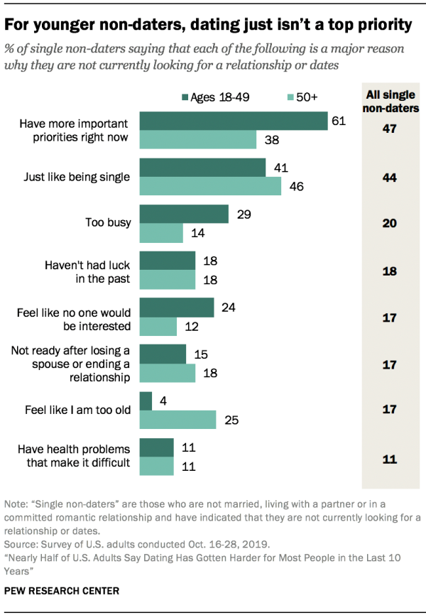
What is SO IMPORTANT that the men/women are doing that they are IGNORING me! Is there something wrong with me or with them?
Men and Women are Self-Sufficient and Independent. What do you have to offer to me that ENHANCES my life and our life together?

Slide 10
I. THE PHYSICAL ATTRACTION
IN
THE FRIENDSHIP STAGE.

Slide 11
I. GENERAL PRINCIPLE ON ATTRACTION.
THE PHYSICAL ATTRACTION BEGINS WITH OBSERVING
THE APPEARANCE AND PRESENCE OF THE PERSON.
BEAUTY IS IN THE EYES OF THE BEHOLDER
.

Slide 12
A. THE ATTRACTION FACTORS OF A MAN
1. His Face 6. His Voice
2. His Smile 7. His Style of Clothing
3. His Eyes 8. His Sense of Humor
4. His Grooming 9. His Vibe-Energy
5. His Hands 10. His Approach
Person’s Physical Appearance and Physical Presence are
GATEWAY to catches one’s eyes.

Slide 13
B. THE ATTRACTION FACTORS OF A WOMAN
1. Her Smile 6. Her Body Language
2. Her Kindness 7. Her Intelligence
3. Her Sense of humor 8. Her Communication Skills
4. Her General body type 9. Her Mouth/Lips
5. Her Eyes 10. Her Style of Clothing
Person’s Physical Appearance and Physical Presence are
INFATUATION with the Persona of the Person. Proverbs 31
says this, “Charm is deceptive, and beauty is fleeting…”

Slide 14
C. MY ATTRACTIVENESS
Rate: Poor, Fair, Good, Very Good,
FACTORS | PERCEPTION OF SELF | PERCEPTION BY OTHERS
My Appearance
My Demeanor
My Speech
My Spirituality
My Skill Set
My Maturity

Slide 15
D. MY ATTRACTIVENESS GROWTH AREAS
FACTORS | AREAS OF IMPROVEMENT
Appearance
My Demeanor
My Speech
My Spirituality
My Skill Set
My Maturity

Slide 16
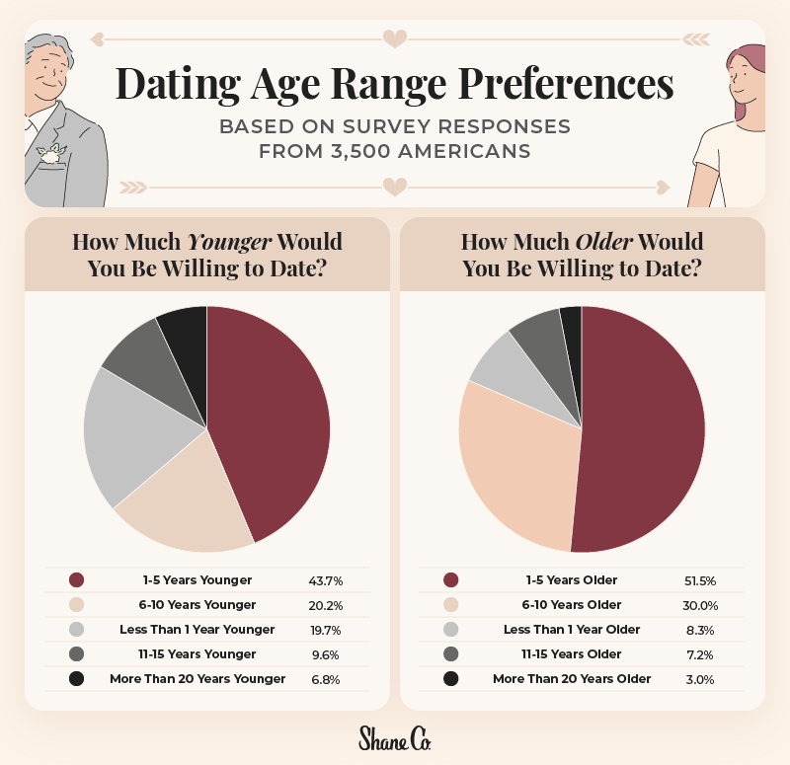
E. Values of Dating
• Affirms Who I am and
my Values
• Develops interpersonal
Skill Relationships
• Reveals the Maturity
of myself and the
other person
• Narrows the Kind of
Person who Complements
my life

Slide 17
F. REASONABLE TIME FRAME FROM DATING TO ENGAGEMENT
1. CASUAL DATING WITHOUT BECOMING “SERIOUS.”
2. “CALIBER” DATING OF 1-2 PERSONS BEING SOMEWHAT
SERIOUS: PROBABLY 2-4 MONTHS.
3. CONSISTENT DATING WITH ONE PERSON BEING SERIOUS:
PROBABLY 6 TO 18 MONTHS.
4. COMMITMENT DATING TOWARD ENGAGEMENT:
PROBABLY 2-8 MONTHS

Slide 18
REFLECTION QUESTIONS:
Which person do you look forward to seeing and being with at our church meetings?
2. Who initiates the contact and how long does it last?
Have you solo date and what was your experience like?
Is there someone who you like to explore a dating
relationship and beyond?

Slide 19
EMOTIONAL BONDING |  | COMMITTED TO
 |  | DEFENSIVE OF
 |  | CRY OVER
 |  | LONG FOR
PHYSICAL BONDING |  | ATTACHED TO
 |  | CARESSING
 |  | KISSING
 |  | TOUCHING
SOCIAL BONDING |  | INTIMATE
 |  | CLOSE
 |  | CASUAL
 |  | ACQUAINTANCE
OVERVIEW OF BONDING
THE LEVEL OF
COMMITMENT
AND
PROGRESSION OF A
RELATIONSHIP
DATING RELATIONSHIP
FRIENDSHIP

Slide 20
II. THE GENERAL PRINCIPLE ON BEHAVIOR:
THE BEHAVIOR ANALYSIS BEGINS BY OBSERVING
AND INTERACTING WITH THE PERSONALITY AND
MATURITY OF THE PERSON.
EACH PERSON IS WEIGHING THE COMMITMENT FACTOR

Slide 21
A. WEIGHING THE TEMPERAMENT FACTOR.
As one interacts with that person, one begins to build a perception of the person. One begins to look at the TEMPERAMENT and PERSONALITY of the Person.
One begins to ask, “IS SHE OR HE THE “RIGHT”
PERSON FOR ME?”

Slide 22
USING THE “UNIQUELY YOU” ASSESSMENT.
1. The VALUE of the “Uniquely You” Assessment.
• Identifies my own Personality Type and what type of
Personality may best complements me.
• Identifies my Spiritual Direction by my Spiritual
Gift/s in my life.
• Identifies satisfaction in Vocation and Ministry
Opportunities
• Instructions on Communication and Conflict Resolutions
I AM FEARFULLY AND WONDERFULLY MADE BY GOD.

Slide 23
THE “UNIQUELY YOU” ASSESSMENT
If you are interested in taking the Uniquely You Assessment, one can take on online. If you wish to have a paper copy of this assessment and would like help in understanding the assessment, please contact, Kingston Tong.
To respect the copyright of the material, the DISC Chart is not included in this presentation but one can look online
on it.

Slide 24
APPLICATION QUESTIONS:
1. What personality types may best complement me?
How do our spiritual and natural gifts complement each other and strengthen our ministries in our church, and in our community?
3. What do I/we envision our life together will be like?
Will we be able to accomplish more for God by being single or
together?

Slide 25
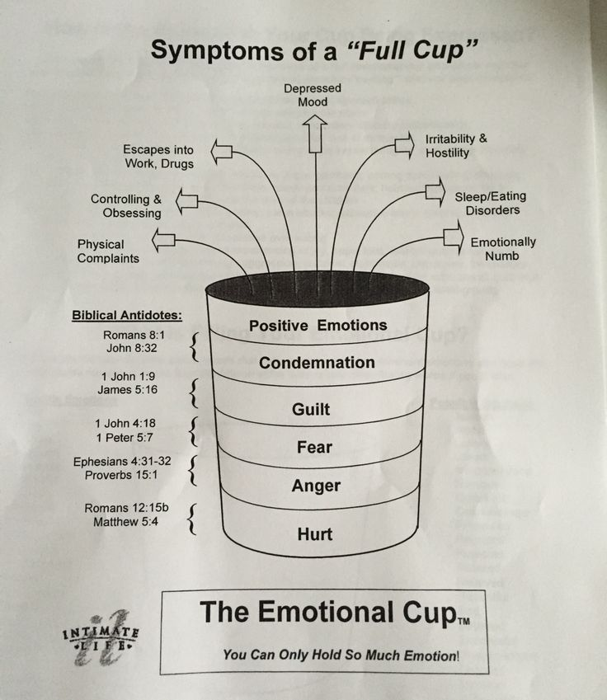
THE EMOTIONAL CUP
Each person’s cup is filled with events and feelings in their lives. Unresolved past and present issues may lead to a root of bitterness that grows in someone life.
Recognizing the hurt and giving forgiveness are the keys to wholesome in one’s emotional and spiritual life.

Slide 26
APPLICATION CHALLENGES:
How is our “emotional baggage” negatively affecting my spiritual, mental, social, and or emotional life?
How will my “emotional baggage” inhibit my relationship with others?
What can I do to resolve hurts and move toward wholeness?

Slide 27
SUMMARY:
A MAN AND A WOMAN MAY FEEL INSECURE BECAUSE HIS OR HER SELF-ESTEEM IS BASED ON PERFORMANCE AND THE OPINION OF OTHERS.
A MAN AND A WOMAN MAY FEEL SECURE WHEN HIS OR HER SELF-ESTEEM IS BASED ON GOD’S UNCONDITIONAL LOVE AND EMPOWERMENT BY THE HOLY SPIRIT.

Slide 28
B. WEIGHING THE MATURITY FACTOR.
As you interact with the period, you begin to form an
opinion as to the maturity of the person. You’re look at the FUNCTIONALITY or the “HOW” that person handles life’s responsibilities in an appropriate and effective manner.
The RESPONDS or REACTIONS to life’s circumstances will
affect your commitment to him/her.

Slide 29
C. AREAS OF MATURITY FACTOR.
• The Purpose of one’s life
• The Spirituality and Spiritual Leadership
• The Acceptance and Fulfilling Commitments
• The Work Ethic and Provision
• The Management of Finances
• The Managing of the Household
• The Resolving of Past and Present Conflicts
• The Display of Social Skills
• The Demonstration of Emotional Balance

Slide 30
REACHING THE HEART OF A MAN
CHERISHED: A sense of NON-JUDGMENTAL and SYMPATHY in his fears, failures and faults.
HONORED: A sense of ACCEPTANCE and DELIGHTING to be with him.
EXALTED: A sense of UNASHAMED private and public praise of him.
RESPECTED: A sense of NOT EMBARASSING him and DEFERRING to his decision.
INTIMATE: A sense of CLOSENESS, CONFIDENTIALITY, and SUPPORT that he can build a life together with you.
SECURE: A sense of COMMITMENT and TRUST in believing in him.
HAPPY: A sense of ENJOYING being with him and HAPPY for him.
HE NEEDS TO FEEL C.H.E.R.I.S.H BY YOU!

Slide 31
REACHING THE HEART OF A WOMAN…
SECURE: A sense of Deep Commitment to her and their Relationship.
PROTECTED: A sense of Being Shielded and Meeting her needs and fears.
ENJOYED: A sense of Having Things in common and Delighting in doing things together.
COURTED: A sense of Thinking about her and Excited over her.
INTIMATE: A sense of Sharing Thoughts, Feelings, and Spiritual Matters.
APPRECIATED: A sense of GIVING Private and Public Gratitude and Praise of her.
LEADERSHIP: A sense of LEADING by Respecting her and Making Good Decisions.
SHE NEEDS TO FEEL S.P.E.C.I.A.L TO YOU!

Slide 32
SUMMARY:
THE BEHAVIOR OR CONDUCT OF THE PERSON REFLECTS WHETHER YOU RESPECT THE OTHER PERSON. THE DISPLAY OF GODLY MATURE ATTITUDE AND SKILLS MAKES THAT PERSON A TRULY VIABLE LIFE COMPANION.
THERE IS THE TRANSITION FROM PHILEO LOVE TO AGAPE LOVE FOR EACH OTHER.

Slide 33
III. THE THIRD PRINCIPLE OF CHARACTER.
THE CHARACTER FACTOR IS OBSERVING AND ACCEPTING OR REJECTING THE CHARACTER STRENGTHS AND FLAWS OF THE PERSON. THE CHARACTER OR TEMPERAMENT IS ONE’S NATURAL BENT FROM BIRTH.
EACH PERSON MUST MAKE A DECISION OF WHETHER SHE OR HE WANTS TO COMMIT TO A LIFELONG RELATIONSHIP.

Slide 34
THE CHARACTER OF THE PERSON.
1. My FIVE Main Characteristics of a Christian.
THE CHRISTIAN MAN | THE CHRISTIAN WOMAN

Slide 35
A. THE CHARACTER OF THE PERSON.
2. TEN Main Characteristics of a Christian Man
• Christ-Centered • Honest
• Faithful • Teachable
• Humble • Pure Heart
• Compassionate • Generous
• Persevering • Selfless

Slide 36
THE CHARACTER OF THE PERSON.
3. TEN Main Characteristics of a Christian Woman.
• Christ centered • Compassionate
• Gracious • Faithful
• Godly • Submissive to the Lord
• Humble/Modest • Respectful to others
• Hospitable • Industrious

Slide 37
B. MY DREAM PERSON AND THE REAL PERSON
• Avoid falling in love with a MIRAGE and not loving the
REAL PERSON (Jud. 14:1-2).
• Coming to a REALISTIC EXPECTATIONS of myself and of
the other persons (I Pet. 3:1-9).
• Developing a REALISTIC APPROACH and GUIDELINE for
marriage (Gen. 29:16-20).
• Having a CHRIST-CENTERED RELATIONSHIP, not a
security based relationship (Eph. 5:22-31).

Slide 38
C. THEORIES ON THE PERSON THAT YOU MAY BE MARRYING
• Theory 1: The image of the perfect person in our mind is a
reflection of the best qualities of my parent’s traits.
• Theory 2: The image of our perfect person is fueled by unmet
childhood need from the opposite-sex parent.
• Theory 3: The image of the perfect person is shaped by the
traits of the influential people in your life.
Most individuals choose a person who complements their
own personality type who may be able to meet the needs
in his/her life.

Slide 39
D. THE CREATION OF MAN AND WOMEN
God made Adam and Eve as Man and Woman. They are physically similar and yet physiologically different. There is gender and identify with oneself and with each other.
Genesis 2, “Then the Lord God made a woman from the rib he had taken out of the man, and he brought her to the man. ²³ The man said, “This is now bone of my bones and flesh of my flesh; she shall be called ‘woman,’ for she was taken out of man.” ²⁴ That is why a man leaves his father and mother and is united to his wife, and they become one flesh.”

Slide 40
E. MOVING TOWARD COMMITMENT
1. AFFECTIONATE CARE, says, “I CARE ABOUT YOU.”
It is caring that REASSURES the other person of your
fondness, concern and attractiveness.
• Giving your undivided attention when one is speaking
• Giving priority time to the other person
• Promoting spiritual values by praying and sharing the
Word with each other.

Slide 41
PHILIPPIANS 2:4, “Each of you should look not only to your own
interests, but also to the interest of others.
APPLICATION CHALLENGES:
Do you give more than your demand from your relationship?
How have you demonstrated genuine affectionate care to the
other person?

Slide 42
MOVING TOWARD COMMITMENT
2. VULNERABLE COMMUNICATION says, “I TRUST YOU.”
It is BEING OPEN about one’s hopes, feelings, needs, and
hurts.
• Confiding your feelings about your past and present struggles
• Sharing your hopes and dreams of your life and life together
• Expressing your emotional needs and hurts in life
• Being honest with your spiritual journey in life.

Slide 43
I JOHN 4:18-19, “There is no fear in love. But perfect love drives out
fear, because fear has to do with punishment. The one who fears is
not made perrect in love. We love because He first loved us.”
APPLICATION CHALLENGES:
What personal secret/s are you keeping to yourself, from others or
from God?
What will it take for you to share and be free from your shame and
guilt?

Slide 44
MOVING TOWARD COMMITMENT
3. JOINT ACCOMPLISHMENT says, “I NEED YOU.”
It is developing COMMON INTEREST and ACCOMPLISHING
projects or goals together.
• Attending and being together in Christian and social activities
• Listening and deciding together on a special ministry together
• Asking and accepting help from each other
• Doing and working together in fulfilling a task together
• Rejoicing and complimenting each other on completed activity

Slide 45
PHILIPPIANS 6:2, “Carry each other burdens, and in this way you
will fulfill the law of Christ.”
APPLICATION CHALLLENGES:
What are the things that I need help in my life?
How do I see the other person fitting into my life?
How do I feel about this person being part of life?

Slide 46
MOVING TOWARD COMMITMENT
4. MUTUAL GIVING says, “I LOVE YOU.”
Love is putting the other person AHEAD of yourself through
words and or actions.
• Calling and being courteous if one is delayed in coming
• Giving gifts other times beyond birthday or Valentine Day
• Forgiving the other each and not holding any grudges
• Declaring to the other person your loyalty and affection

Slide 47
PHILIPPIANS2:3, “Do nothing out of selfish ambition or vain conceit, but
in humility consider others better than yourselves.”
APPLICATION CHALLENGES:
1. When you are asked to do something, how do you feel about it?
2. How do you feel if s/he does appreciate what you did or gave to
him or her?
3. What are the ways that you can express your love to him or her?

Slide 48
BOUNDARIES ON PHYSICAL AFFECTION
Discussion Questions:
What is the boundary of physical affection when one is dating?
What is the boundary when one is going steady?
What do you do when a person wants to be more physically
intimate than you want to go or violates your conscience?
D. What does the Bible say about inappropriate conduct?

Slide 49
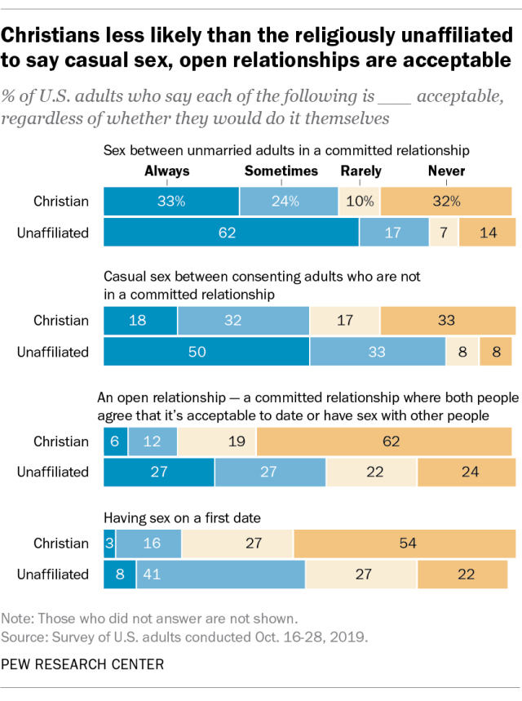
Question:
How much Physical Intimacy is PERMISSIBLE or NOT PERMISSIBLE when you are dating someone?
Are we guided by God’s Word or guided by our feelings at the moment?

Slide 50
SUGGESTED BOUNDARY ON PHYSICAL CONTACT.
• From Dating to Engagement, the LIMIT of physical
contact is HOLDING HANDS.
• From Engagement to the Wedding Avow, the LIMIT of
physical contact is LIGHT KISSING.
In seeking to GLORIFY God, one HONORS the person and that person’s body. If the relationship ends for whatever reasons, one has nothing to be embarrassed when seeing that person or sharing about one’s past dating relationships.

Slide 51
CONCLUSION:
BEAUTY IS THE ATTRACTION FACTOR.
MATURITY IS THE WEIGHING FACTOR.
CHARACTER IS THE DECIDING FACTOR.

Slide 52
APPLICATION:
IF YOU FIND A MAN OR WOMAN WHO TRULY LOVES GOD AND LOVE HIS/HER NEIGHBOR AS HIM/HERSELF, YOU HAVE DISCOVER A DIAMOND FOR YOUR LIFE.
THAT PERSON WILL HAVE UNCONDITIONAL LOVE AND CARE FOR YOU, BEING FAITHFUL TO YOU ALL THE DAYS OF HIS/HER LIFE.
LOOK FOR CHARACTER OF THE PERSON, NOT BEAUTY OR EVEN ONE’S FINANCIAL SECURITY FOR LIFE.

Slide 53
ACKNOWLEDGMENTS:
Pros and Cons of Being Single by prosancon.com
The Average Dating Range in the US by State.Shane Co
Uniquely You
The Emotional Cup by Pinterest
15 Amazing Qualities of a Godly Man@marriage.com
Pew Research Center 2019

