Slide 1
LESSON TITLE:
THE PASCHAL LAMB

Slide 2
QUESTION:
HOW DOES JESUS CHRIST FULFILL THE JEWISH PASSOVER LAMB?

Slide 3
PURPOSE:
EXPLORE THE PARALLELISM BETWEEN THE PASSOVER LAMB AND THE LAMB OF GOD.

Slide 4
THE JEWISH CALENDAR YEAR BEGINS ON THE 10TH DAY OF NISSAN AND CONCLUDES WITH THE FEAST OF TABERNACLE IN THE MONTH OF TISHRI.
THE FESTIVALS WERE PRIMARY IN THE SPRING AND IN THE FALL, CALLING THE ISRAELITES TO RECALL THAT THEY ARE A REDEEMED PEOPLE.

Slide 5
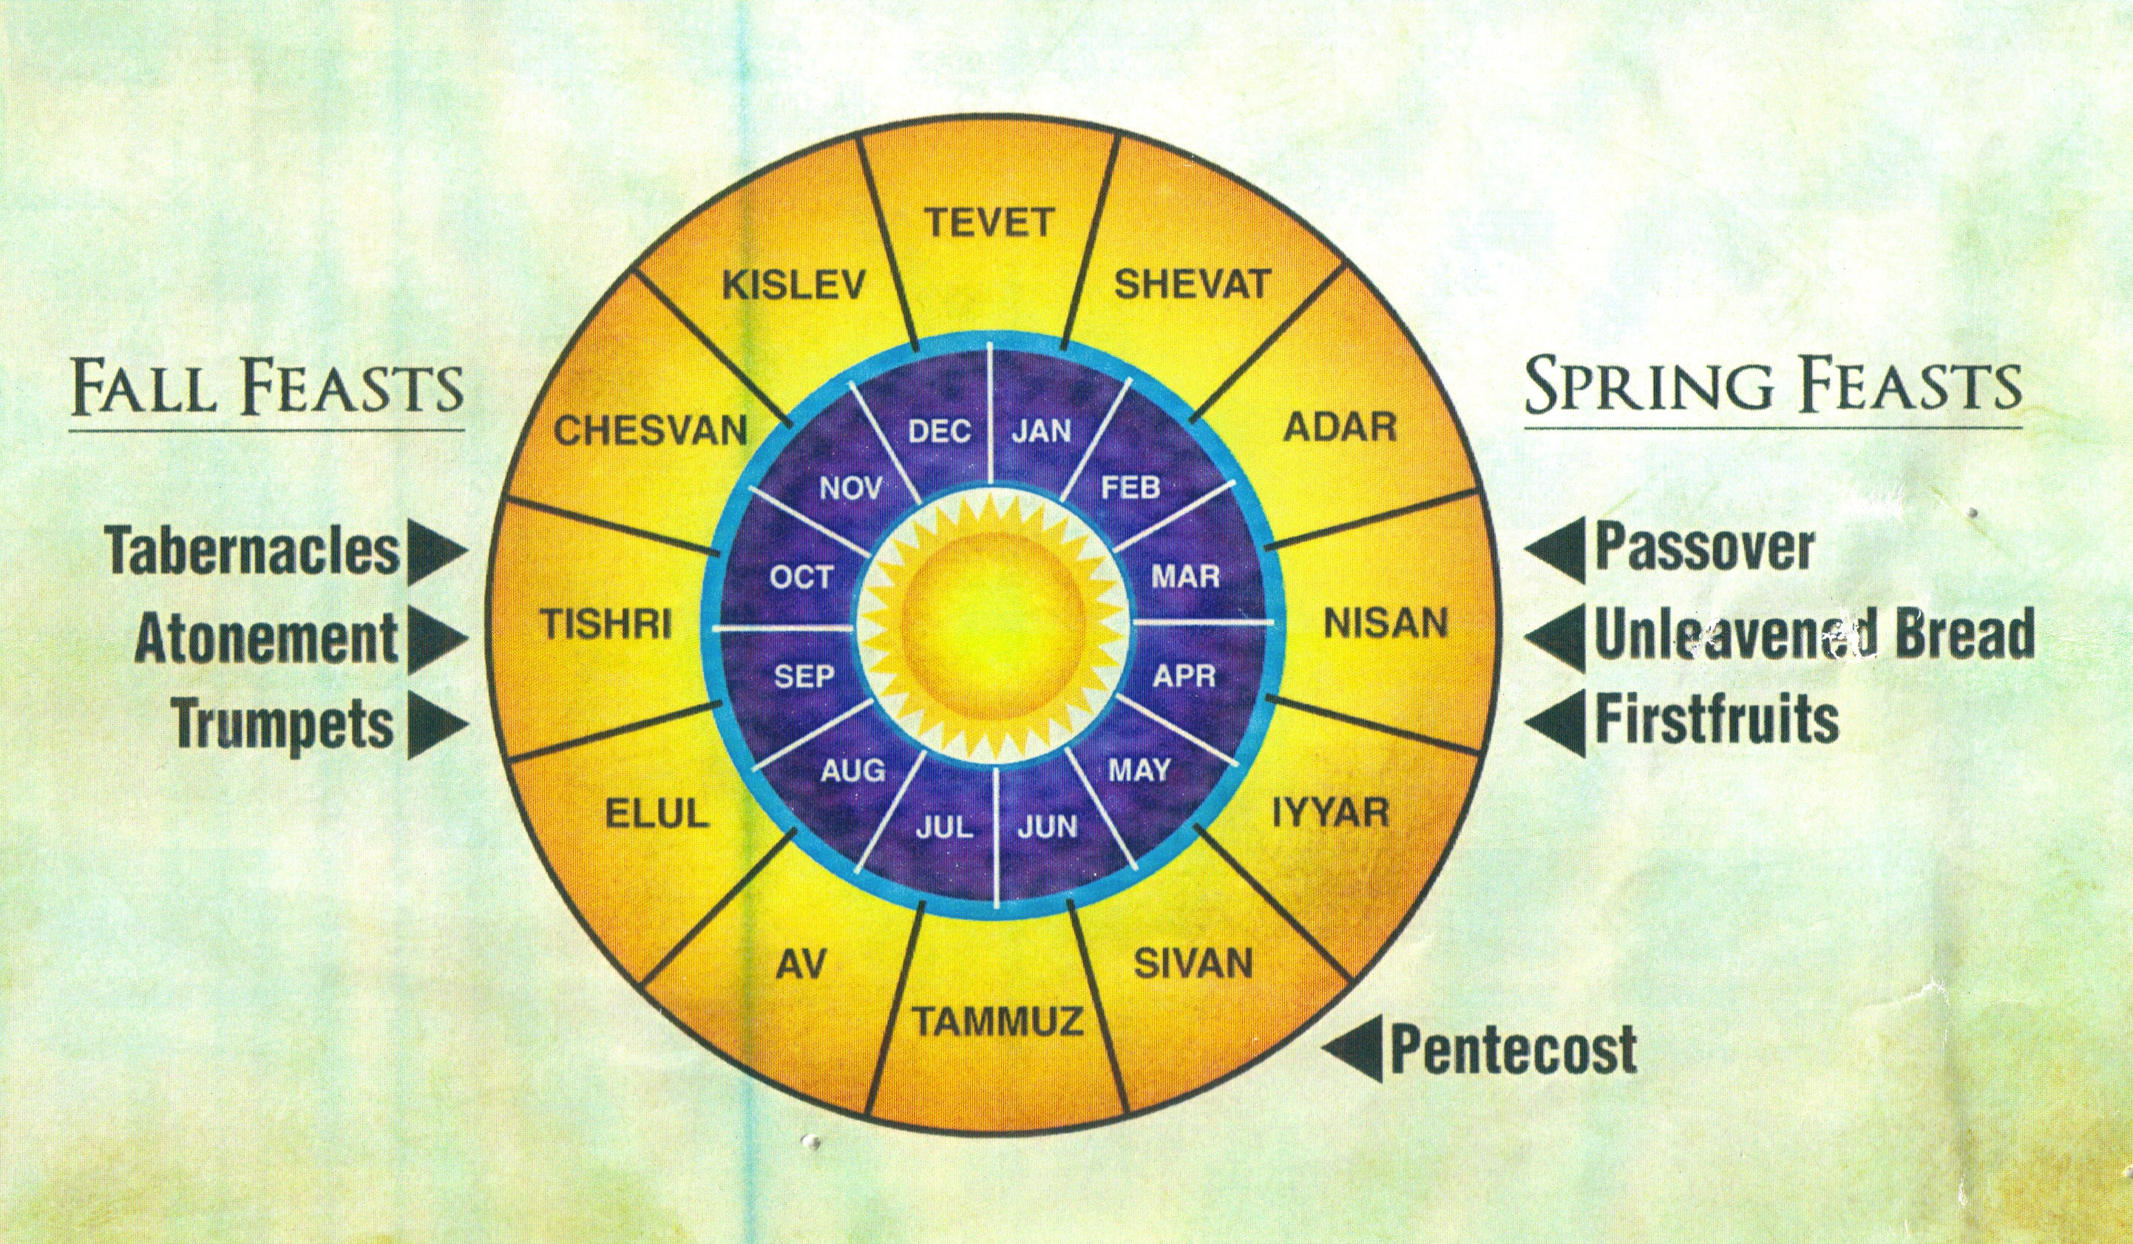
THE JEWISH CALENDAR

Slide 6
Exodus 12:
The Lord said to Moses and Aaron in Egypt, ² “This month is to be for you the first month, the first month of your year. ³ Tell the whole community of Israel that on the tenth day of this month each man is to take a lamb for his family, one for each household. ⁴ If any household is too small for a whole lamb, they must share one with their nearest neighbor, having taken into account the number of people there are. You are to determine the amount of lamb needed in accordance with what each person will eat.

Slide 7
⁵ The animals you choose must be year-old males without defect, and you may take them from the sheep or the goats. ⁶ Take care of them until the fourteenth day of the month, when all the members of the community of Israel must slaughter them at twilight. ⁷ Then they are to take some of the blood and put it on the sides and tops of the doorframes of the houses where they eat the lambs.

Slide 8
⁸ That same night they are to eat the meat roasted over the fire, along with bitter herbs, and bread made without yeast. ⁹ Do not eat the meat raw or boiled in water, but roast it over a fire—with the head, legs and internal organs. ¹⁰ Do not leave any of it till morning;
if some is left till morning, you must burn it. ¹¹ This is how you are to eat it: with your cloak tucked into your belt, your sandals on your feet and your staff in your hand. Eat it in haste; it is the Lord’s Passover.

Slide 9
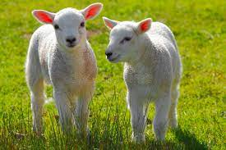
THE PASSOVER LAMB AND JESUS
The LAMB was CHOSEN on the
10th DAY of Nissan (vs. 3).
Every family or household were
to select a lamb for their family.
The lamb had to be selected by
the 10th Day of Nissan, the first month of the Jewish calendar.

Slide 10
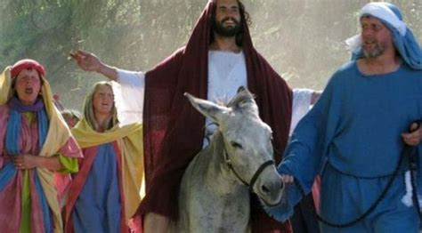
THE PASSOVER LAMB AND JESUS
THE PARALLELISM 1:
JESUS was CHOSEN by the people.
Jesus entered into Jerusalem on the
10th DAY of Nissan (Matt. 21:1-11).
They HAILED him as the Messiah
on the Sabbath before the Passover,
not realizing that He would become their Paschal Lamb.

Slide 11
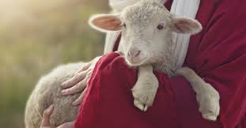
2. The LAMB must be a MALE,
ONE YEAR OLD, and
WITHOUT BLEMISH (vs. 5).
The head of the family was to
select one lamb, the best
lamb to be sacrificed.
The lamb was to be carefully
looked over so as to be
without any defect at all.

Slide 12
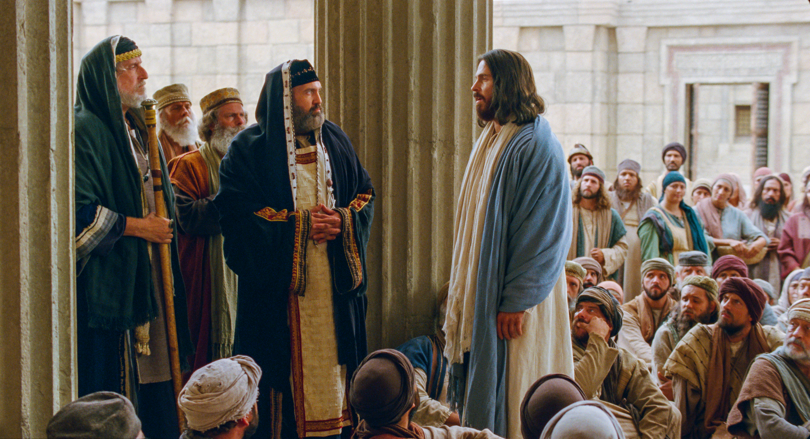
PARALLELISM 2:
JESUS was at the PRIME
of his life. He was found to
be WITHOUT BLEMISH.
The Jewish leaders questioned
Jesus and COULDN’T FIND
any FAULT with Him (Matt.
22:15-45). He was WITHOUT BLEMISH.

Slide 13
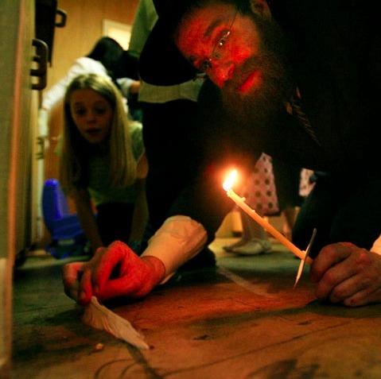
3. The REMOVAL of LEAVEN
in the home (vs. 8).
Every Jewish home was to
remove all leaven from their
house.
Leaven causes the bread to
rise, equivalent to yeast. The
removal of leaven was to
symbolize the removal of
anything impure or sin.

Slide 14
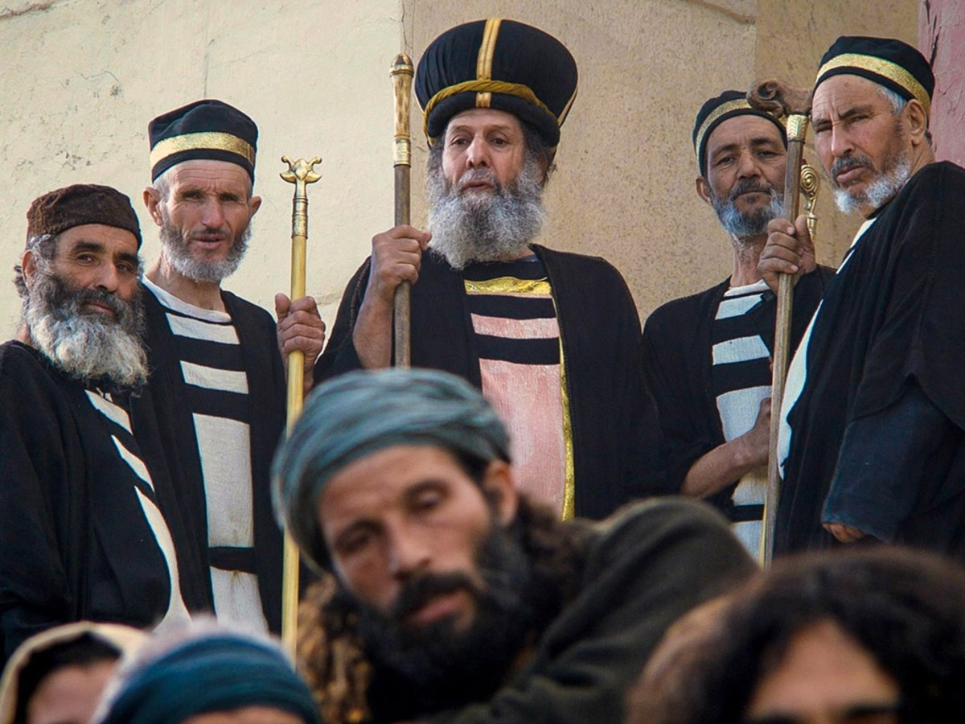
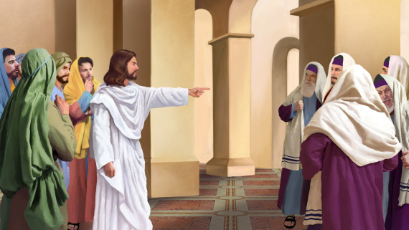
PARALLELISM 3:
Jesus EXPOSES the
HYPROCISY of the JEWISH
LEADERS in the Temple of
God (Matt. 22:1-39).
The priests were to sweep
clean of any impurity in the
house of God. Jesus points
out the leaven in the house
of God.

Slide 15
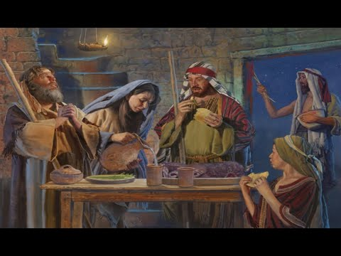
4. A Passover MEAL was
PREPARED and EATEN on
the 14th Day of Nissan
(vs. 8a).
Every Jew was to celebrate
and remember the Day by
eating the same type of
food on the 14th Day of
Nissan.

Slide 16
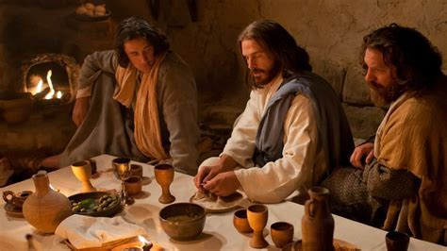
PARALLELISM 4.
Jesus started the Passover
Meal on Thursday evening
(the 13th Day of Nissan) and
completed it on the Friday
evening (14th Day of Nissan).
We must remember that at
sunset, the Jewish day
begins not at sunrise.

Slide 17
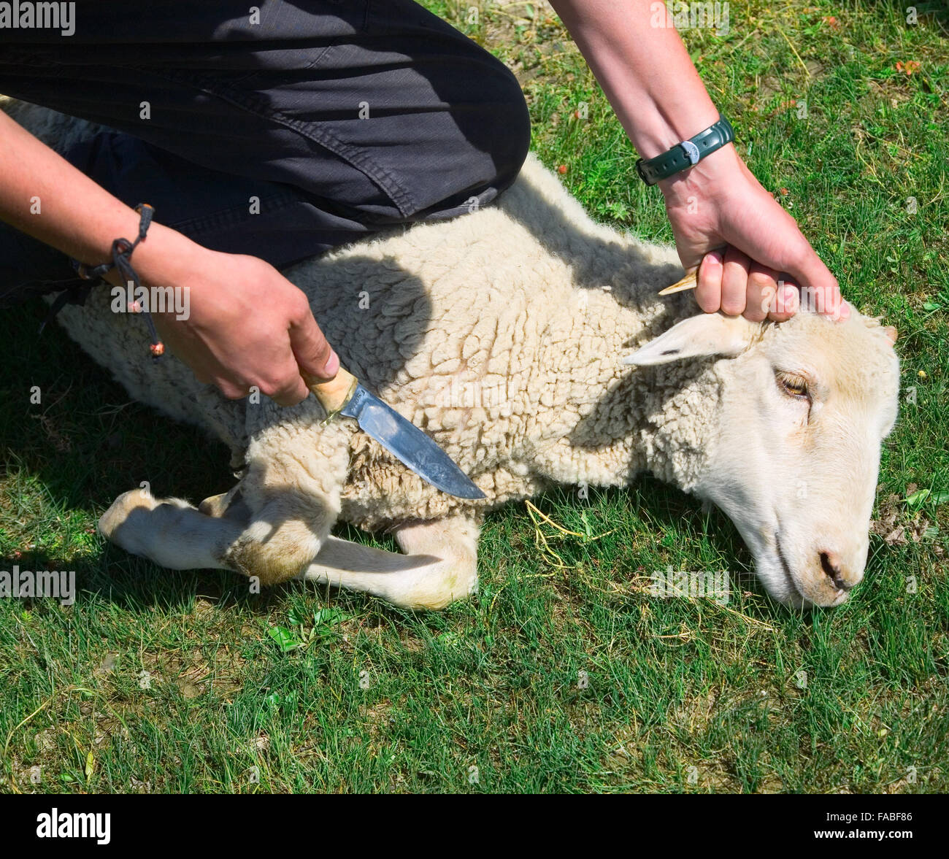
5. The PASSOVER LAMB was
to be KILLED on the
TWILIGHT of the 14th Day
of Nissan (vs. 6).
The head of the household
was the one responsible
for the slaying of the lamb.

Slide 18
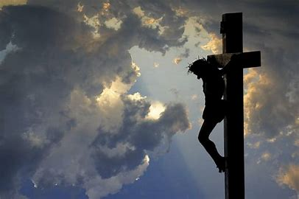
PARALLELISM 5:
The Jewish leaders demanded
that Pilate crucify Jesus.
The Jews could have had
Jesus stoned, but they
wanted him to be crucified.
Jesus DIED on the TWILIGHT
of 14th Day of Nissan (Matt.
27:45-54).

Slide 19
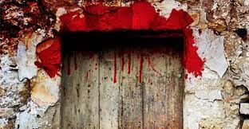
The blood of the lamb
was placed on the door
frame of the house (vs. 7).
This was to be reminder
that the Angel of Death by-
pass their house even as
he slayed the firstborn of
Egypt.

Slide 20
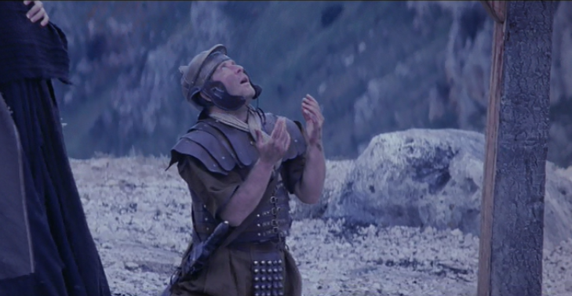
PARALLELISM 6:
Jesus’ crucifixion reflects
the blood being put on the
door frame of each home.
By FAITH, one puts the
BLOOD of Jesus
on the doorway of one’s
heart to ESCAPE spiritual
death (I John 2:2).

Slide 21
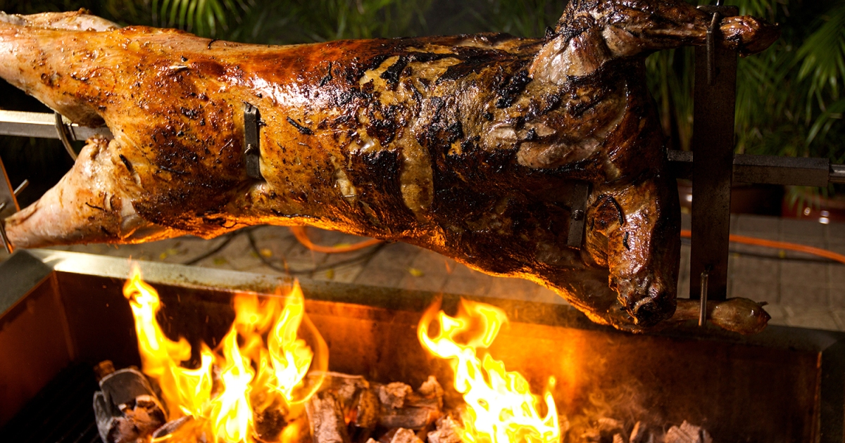
The lamb was to be EATEN or REMOVED by the people BEFORE the dawn of the next day (vs. 10).
The sacrificed lamb was to be
eaten by everyone and any
remaining part was to be
burned so that nothing
remains of it.

Slide 22
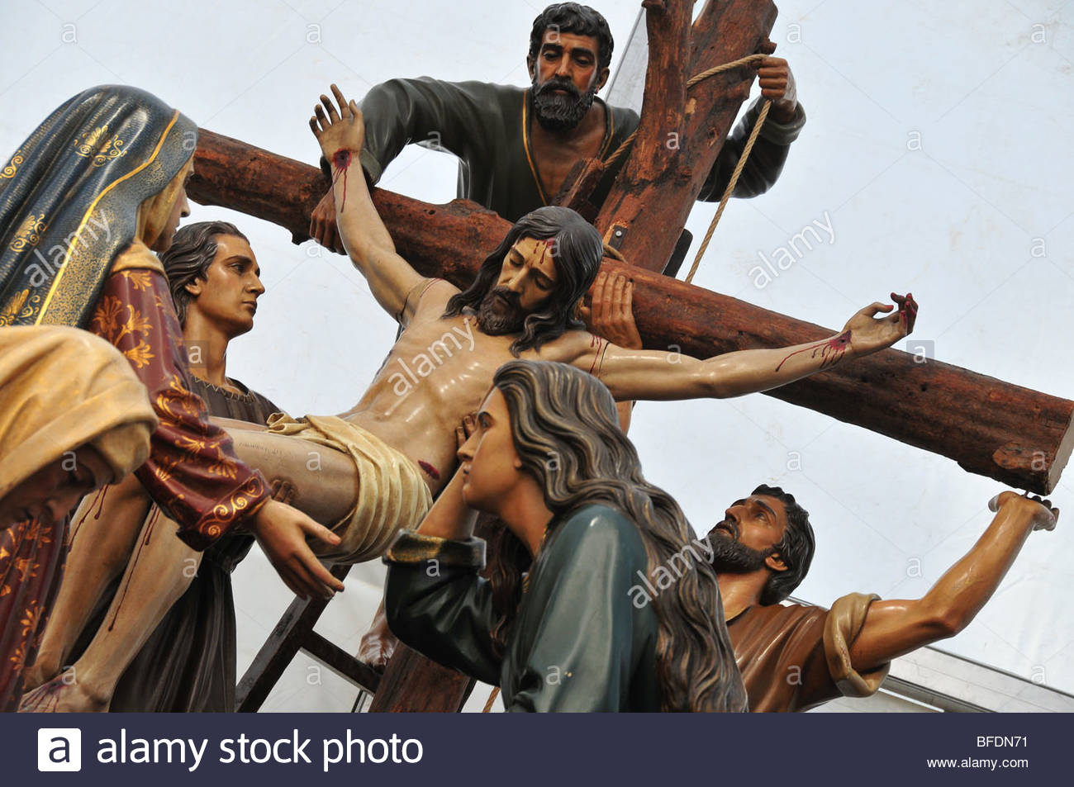
PARALLELISM 7:
Holy Communion represents
partaking/eating the Lamb of
God (Matt. 26:26-28).
Jesus was taken down
from the cross BEFORE
the beginning of the
Sabbath Day (Matt. 27:57-61).

Slide 23
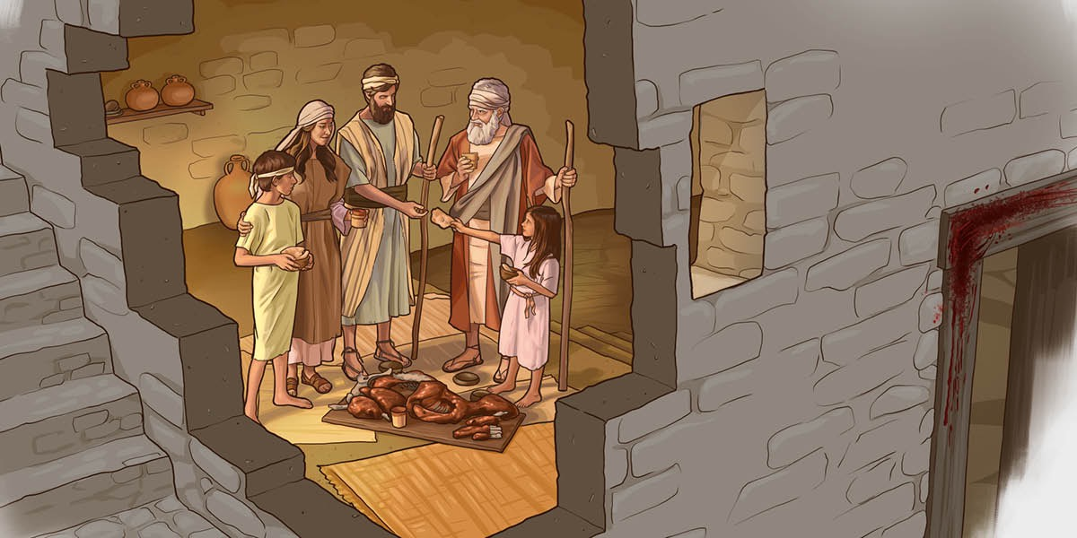
The people were to eat
the Passover Meal in
HASTE (vs. 11).
Deliverance from their
Egyptian bondage was
imminent. They were to
be ready to leave at
Moses command.

Slide 24
PARALLELISM 8.
Believers are to be
HASTE in leaving the
bondage of sin, never
to look back again.
We are free from the
bondage of sin. We
don’t have to sin.

Slide 25
BIBLICAL TRUTH:
JESUS CHRIST IS OUR PASSOVER LAMB.
I CORINTHIANS 7:7B-8
“For Christ, our Passover lamb, has been sacrificed. ⁸ Therefore let us keep the Festival, not with the old bread leavened with malice and wickedness, but with the unleavened bread of sincerity and truth.”

Slide 26
APPLICATION FOR THE WEEK:
WHAT OLD LEAVEN/HABITS DO YOU NEED TO GET RID
OF IN YOUR LIFE SO THAT JESUS CAN SHINE THROUGH
IT?
WHEN I CONFESS MY SINS TO GOD, GOD WILL FORGIVE ME. WHAT UNCONFESSED SINS AM I HIDING FROM GOD?
AM I READY TO LEAVE SINFUL BEHAVIOR BEHIND OR
AM I STILL HOLDING ONTO IT?

Slide 27
CLOSING PRAYER:
“Dear Heavenly Father,
Thank you for giving Jesus to us as our Passover Lamb. Thank you Jesus for dying for us so that we are free from
the fear of death and the sting of death.
We believe that you died for our sins and rose again on the third day. Help us to live godly lives so that people can see Jesus through our words and actions. In Jesus’ Name. Amen.

Slide 28
NEXT WEEK LESSONS
THE PASSOVER MEAL
AND
THE LORD’S SUPPER

