Slide 1
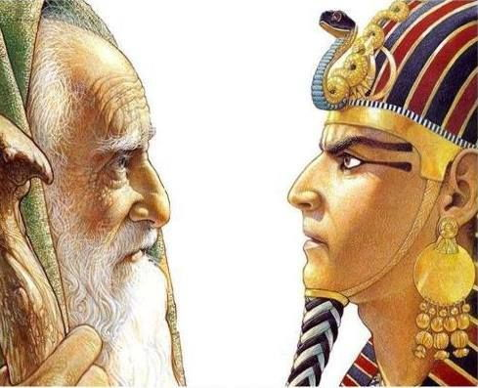
THE PHARAOHS OF EGYPT AND THE ISRAELITES

Slide 2
THE PURPOSE OF THE STUDY
THE PHARAOHS AND THE HEBREWS
A CLOSER LOOK AT HOW GOD FULFILLED HIS PLAN TO RAISE UP THE DESCENDANTS OF ABRAHAM TO BECOME A NATION IN THE LAND OF EGYPT AND THEIR DELIVERANCE FROM THAT LAND.
GOD USED THE HYKSOS AND THE EGYPTIANS TO FULFILL TWO KEY PROMISES TO ABRAHAM AND SARAH.

Slide 3
I. THE CALL OF GOD TO ABRAHAM AND SARAH.
A. THE PROMISED BLESSINGS TO ABRAHAM (Gen. 12:1-3).
The Lord had said to Abram, “Go from your country, your people and your father’s household to the land I will show you.
² “I will make you into a great nation, and I will bless you; I will make your name great, and you will be a blessing.^{[a]} ³ I will bless those who bless you, and whoever curses you I will
curse; and all peoples on earth will be blessed through you.”^{[b]}

Slide 4
B. THE PROMISE OF THE LAND GRANT (GENESIS 15:12-20).
As the sun was setting, Abram fell into a deep sleep, and a thick and dreadful darkness came over him. ¹³ Then the Lord said to him, “Know for certain that for four hundred years your descendants will be strangers in a country not their own and that they will be enslaved and mistreated there. ¹⁴ But I will punish the nation they serve as slaves, and afterward they will come out with great possessions. ¹⁵ You, however, will go to your ancestors in peace and be buried at a good old age. ¹⁶ In the fourth generation your descendants will come back here, for the sin of the Amorites has not yet reached its full measure… ¹⁸On that day the Lord made a covenant with Abram and said, “To your descendants I give this land, from the Wadi^{[e]} of Egypt to the great river, the Euphrates— ¹⁹ the land of the Kenites, Kenizzites, Kadmonites, ²⁰ Hittites, Perizzites, Rephaites, ²¹ Amorites, Canaanites, Girgashites and Jebusites.”

Slide 5
C. KEY OBSERVATIONS ON GENESIS 12, 15
• Abram’s descendants will become a nation.
• Abram’s descendants will be blessed and whoever curses them
will be cursed.
• Abram’s descendants will be in a foreign land for 400 years.
• Abram’s descendants will be enslaved and mistreated.
• Abram’s descendants will be delivered by God and leave with
riches from that country.
• Abram’s descendants will return to the Promised Land in the
“fourth” generation.
• Abram’s descendants will occupy the Promised Land.
• A descendant of Abram will bless the whole earth.

Slide 6
D. KEY QUESTIONS ON GENESIS 15:12-16
1. How will God bring Abram’s descendants to that country?
2. How will the Abram’s descendants be enslaved and by whom?
3. How will God delivered Abram’s descendants from that
country?
4. How and who are the individuals who belongs to the “fourth
generation” of Abram’s descendants?
5. How will Abram’s descendants enter into the Promised Land?

Slide 7
THE SOVEREIGNTY OF GOD OVER ISRAEL AND EGYPT.
A. GOD LEADS ABRAHAM’S DESCENDANTS INTO EGYPT.
Joseph says this to his brothers in Genesis 50, “¹⁹ But Joseph said to them, “Don’t be afraid. Am I in the place of God? ²⁰ You intended to harm me, but God intended it for good to accomplish what is now being done, the saving of many lives. ²¹ So then, don’t be afraid. I will provide for you and your children.” And he reassured them and spoke kindly to them.”
Joseph is sold by his brothers into Egypt and rises to be Prime Minister of Egypt. This is the beginning of the 400 years into a foreign land in Egypt.

Slide 8
GOD RAISES UP THE PHARAOHS OF EGYPT.
The Apostle Paul says in Rom. 9, “16 It does not, therefore, depend on human desire or effort, but on God’s mercy. 17 For Scripture says to Pharaoh: “I raised you up for this very purpose, that I might display my power in you and that my name might be proclaimed in all the earth.”[g] 18 Therefore God has mercy on whom he wants to have mercy, and he hardens whom he wants to harden.”
Joseph rises to become Prime Minister of Egypt most likely under the reign of the Hyksos. The Israelites were blessed under the rule of the Hyksos but became enslaved under the Pharaohs of Egypt. The New Kingdom of Egypt brought a new pharaoh and a new dynasty that ultimately leads to the Hebrews leaving Egypt to the Promised Land.

Slide 9
C. GOD RAISES UP THE PHARAOH’S OF EGYPT
Old Kingdom (ca. 2675 - 2130 B.C.E)
Dynasty 3 (ca. 2675 - 2625 B.C.E.) Step Pyramids Begins
Dynasty 4 (ca. 2625 - 2500 B.C.E) Giza Pyramids Begins
Dynasty 5 (ca. 2500 - 2350 B.C.E.)
Dynasty 6 (ca. 2350 - 2710 B.C.E)
Dynasties 7-8 (ca. 2170 - 2130 B.C.E.)
First Intermediate Period (ca. 2130 - 1980 B.C.E.) Karnack Temple Begins
Dynasties 9-10 (ca. 2130 - 1970 B.C.E.) Joseph in Egypt?
Dynasty 11, Part I (ca. 2081 - 1980 B.C.E.)
Middle Kingdom (ca. 1980 - 1630 B.C.E.)
Dynasty 11, Part II (ca. 1980 - 1938 B.C.E)
Dynasty 12 (ca. 1938 - 1759 B.C.E.)
Dynasty 13 (ca. 1759 - after 1630 B.C.E.)
Dynasty 14 (dates uncertain, but contemporary with later
Dynasty 13)

Slide 10
Second Intermediate period (ca. 1630 - 1539/1523 B.C.E)
Dynasty 15 (ca. 1630 - 1523 B.C.E.)
Dynasty 16 (dates unknown: minor Hyksos rulers,
contemporary with Dynasty 15)
Dynasty 17 (ca. 1630 - 1539 B.C.E.)
New Kingdom (ca. 1539 - 1075 B.C.E.) Valley of the Kings
Dynasty 18 (ca. 1539 - 1292 B.C.E.)
Dynasty 19 (ca. 1292 - 1190 B.C.E.)
Dynasty 20 (ca. 1190 - 1075 B.C.E.)
Notation: The names of the Pharaoh are well established, but the
assigned dates of the Pharaoh are still dispute. Thus my
focus is not so much on the dates but the lineage and legacy
of the Pharaohs as it relates to the biblical narratives.

Slide 11
D. GOD FULFILLS HIS PROMISE TO ABRAHAM (EX. 1-15). | DATES?
Ahmose I: The Father of the New Kingdom Expelled the Hyksos people from Egypt Enslavement of the Hebrews (?) | ca. 1550–1525 B.C.
Amenhotep I: Rebuilding and expanding Valley of the Kings | ca. 1525–1504 B.C.
Thutmose I: The Adoption of Moses? | ca. 1504–1492 B.C.
Hatshepsut: Co-regent with Thutmose II Co-regent with Thutmose III Queen Hatshepsut | ca. 1492–1479 B.C. ca. 1479–1473 B.C. ca. 1473–1458 B.C.
Thutmose III: Warrior Pharaoh Builder of Egypt Thutmose III the Pharaoh of the Exodus? | ca. 1458–1425 B.C.
Amenhotep II: Maintain Egypt and expanded Karnack | ca. 1425-1400 B.C.
Thutmose IV: The Wilderness Wandering ? ca. 1400-1390 B.C. Amenhotep III: ca. 1390-1353 B.C.

Slide 12
III. THE EXODUS ANDTHE PHARAOHS.
A. KEY PASSAGES ON THE BIBLICAL DATES FOR THE EXODUS.
I Kings 6:1 “In the four hundred and eightieth^{[a]} year after the Israelites came out of Egypt, in the fourth year of Solomon’s reign over Israel, in the month of Ziv, the second month, he began to build the temple of the Lord.” See also Acts 13:17-21 with a slight variant years.
Judges 11:26, “²⁵ Are you any better than Balak son of Zippor, king of Moab? Did he ever quarrel with Israel or fight with them? ²⁶ For three hundred years Israel occupied Heshbon, Aroer, the surrounding settlements and all the towns along the Arnon. Why didn’t you retake them during that time?”

Slide 13
B. THE CRITICAL QUESTIONS:
THE CRITICAL QUESTION IS THE DATING OF THE REIGN OF KING SOLOMON. THE BIBLE STATES THAT IT WAS 480 YEARS AFTER THE ISRAELITES CAME OUT OF EGYPT THAT KING SOLOMON BEGAN TO BUILD THE TEMPLE OF GOD IN THE FOURTH YEAR OF HIS REIGN.
CONSERVATIVE CHRISTIAN SCHOLARS DATE THE FOURTH YEAR OF KING SOLOMON TO CA. 967 BCE. THIS WILL MAKE THE EXODUS ABOUT 1447 BCE.
THUS, WHO IS/ARE THE PHARAOH(S) OF THE EXODUS AND HOW DOES THEIR LIVES INTERSECT WITH THE EXODUS?

Slide 14
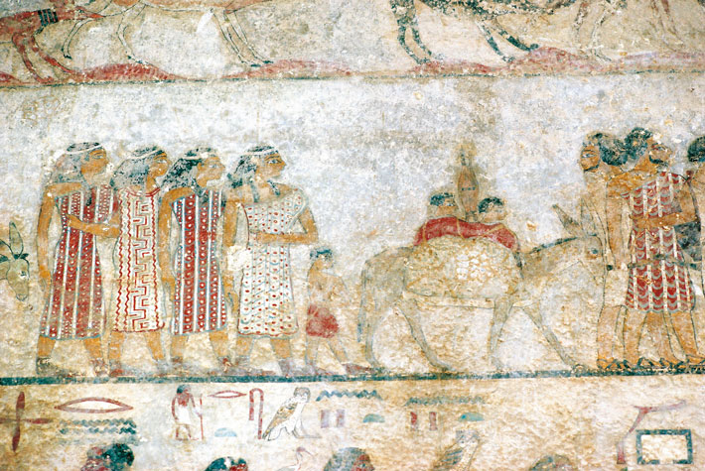
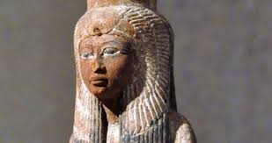
THE RISE OF THE HYKSOS PHARAOHS AND RULE.
• The Hyksos were most likely of Canaanite origin.
• The Hyksos “invaded” and ruled Northern Egypt from 1690-1523 BCE.
• The Hyksos’ capital was Avaris, located in the Delta Region of Egypt.
• The Hyksos’ religion was the worship of Baal and Egyptian’s deities.
• The Hyksos’ appearances were different from the Egyptians.

Slide 15
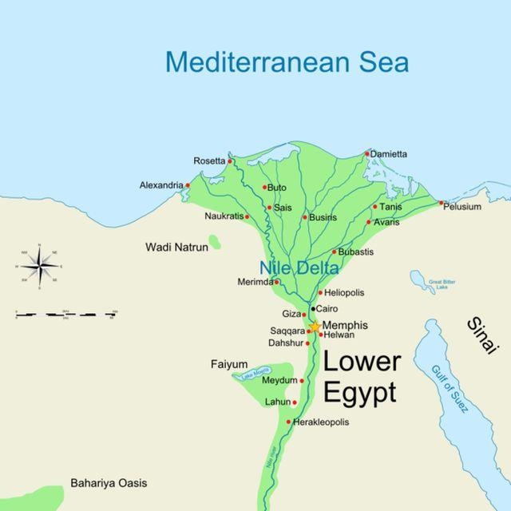
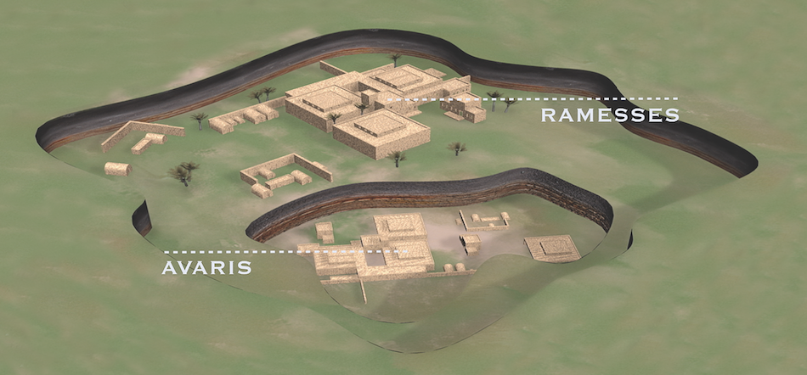
THE HYKSOS TERRITORIAL RULE AND THE HEBREWS IN GOSHEN.
Archaeologists discovered Avaris buried near Ramesses Palace.

Slide 16
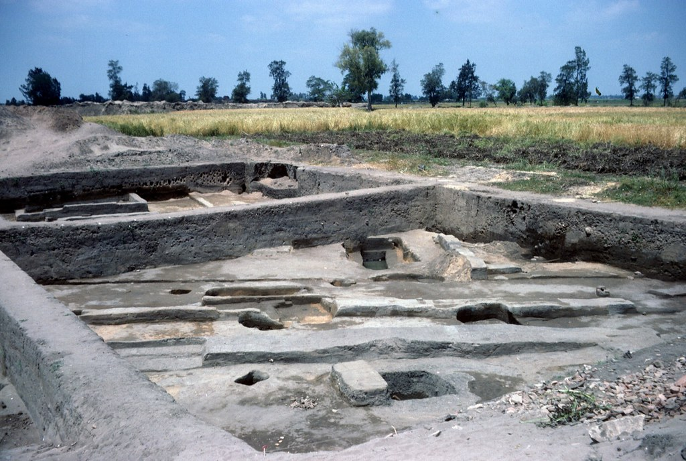
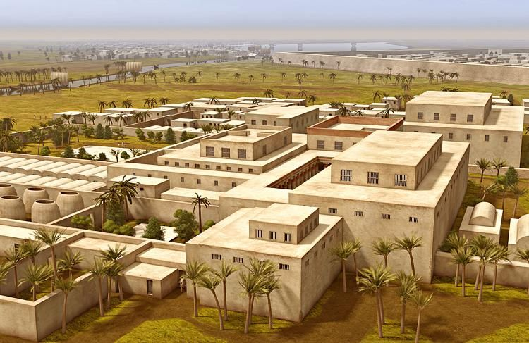
RUINS AND DEPICTION OF THE CITY OF AVARIS
Discussions continues whether the Hyksos were invaders or insurrectionist which includes their origin.

Slide 17
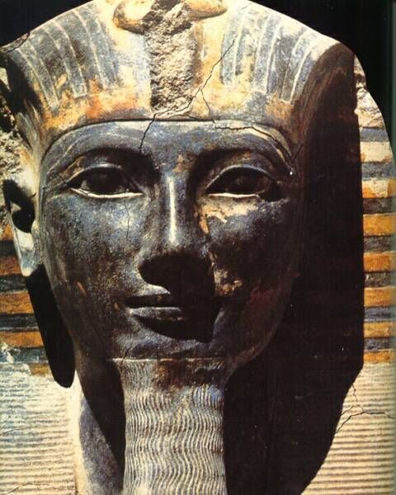
V. THE RISE OF THE LINEAGE OF AHMOSE I TO THUTMOSE III
The LISTING of the Pharaohs is generally not disputed but the DATES of the Pharaoh are still not a settle issue.

Slide 18
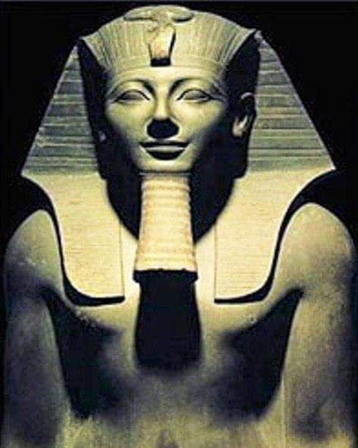
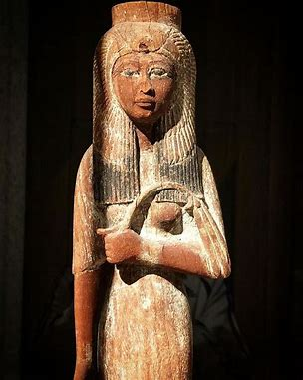
A. THE LINEAGE OF AHMOSE I AND HIS WIFE AHMOSE-NEFERTARI
FIRST RULERS OF THE NEW KINGDOM

Slide 19
AHMOSE I (ca. 1550-1525 BCE).
1. OVERVIEW OF THE LIFE OF AHMOSE I.
• Ahmose means “The Moon is Born.”
• Ahmose I’s mother, Ahhotep raised, encouraged him to expel the
invaders of Egypt in the Middle and Northern region of Egypt.
• Ahmose I defeats and expelled the Hyksos ruler and people from
Egypt.
• Ahmose I united the Southern and Northern Kingdom.
• Ahmose I established Thebes as the capitol of Egypt.
• Ahmose I begins resumes the building of Temples in Karnack.
• Ahmose I married his sister, Ahmose-Nefertari his chief
wife. They had several children.

Slide 20
A2. AHMOSE I MILITARY CAMPAIGNS.
Ahmose I resumed attacks on the Hyksos after his father, Pharaoh Seqenenre Tao and brother Kamose were killed in earlier battles. He was able to defeat the strongholds of Memphis and Avaris, retaking Heliopolis. He laid siege to the Hyksos fortress at Sharuhen for six years, forcing them to retreat. He, then, led his army to Nubia (Kush) imposing his control as far as the Second Cataract and installed a Viceroy in Buhen to acquire gold and copper for his rule.
While Ahmose I was in Nubia, Hyksos sympathizers led by Teti-en tried to seize the throne. However, his mother, Queen Ahhotep quashed the rebellion and maintained power until the return of her son. For her bravery, the Pharaoh awarded her “the gold flies”. He continued his military campaign into the northward into the Canaanites territory even
to the Euphrates River.

Slide 21
A3. POSSIBLE RELEVANCE TO THE EXODUS.
“8 Then a new king, to whom Joseph meant nothing, came to power in Egypt. 9 “Look,” he said to his people, “the Israelites have become far too numerous for us. 10 Come, we must deal shrewdly with them or they will become even more numerous and, if war breaks out, will join our enemies, fight against us and leave the country” (Exod. 1:8-10).
Thought:
It does not appear that the Israelites joined the Hyksos in their battles against the Egyptians, but the Israelites co-existed with the Hyksos. The Egyptians may see the Israelite a real threat to their country since they were viewed as part of the expelled Canaanite people group.
Question: Could the new king of Egypt be Ahmose I?

Slide 22
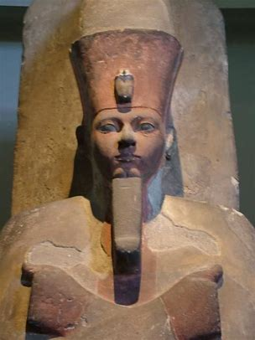
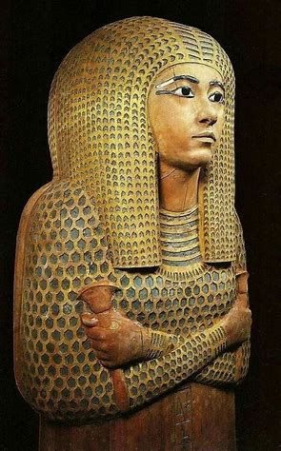
B. THE LEGACY OF AMENHOTEP I AND HIS WIFE AHMOSE-MERITAMUN.
SECOND RULER OF THE MIDDLE KINGDOM

Slide 23
AMENHOTEP I (ca. 1525–1504 BCE).
1. OVERVIEW OF THE LIFE OF AMENHOTEP I.
• Amenhotep means "Bull who conquers the lands.“
• Amenhotep built garrisons to ensure the safety of Egypt.
• Amenhotep I continued rebuilding the Temples of Egypt.
• Amenhotep I built his temple at the north end of Deir el-Bahri.^{[37}}
where Queen Hatshupsut built her temple over his temple.
• Amenhotep I finalized “Book of What is in the Underworld.”
• Amenhotep I had no children through Queen Meritamun.
• Amenhotep I had a son through a concubine, Senisoneb,

Slide 24
B2. THE CONSTRUCTIONS UNDER AMENHOTEP I.
Amenhotep I reign was primarily peaceful. This peaceful reign enabled him to restore temples and erect elaborately designed monuments. His most famous structures are located at the temple of Karnak, where he erected a massive limestone gateway that may have been the main Southern entrance to the temple.
Another of Amenhotep's structures was a bark shrine that he built to honor the god Amun and a chapel at Abydos that was dedicated in his father's honor. Although Amenhotep both began and continued many building projects during his reign, most of the structures were subsequently destroyed by pharaohs. There are no known structures in Lower Egypt by Amenhotep. All of his buildings were located in Upper Egypt.

Slide 25
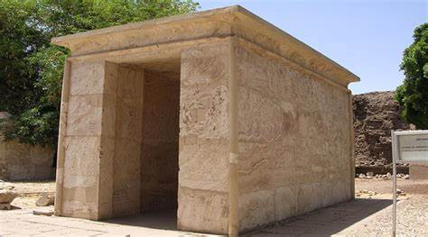
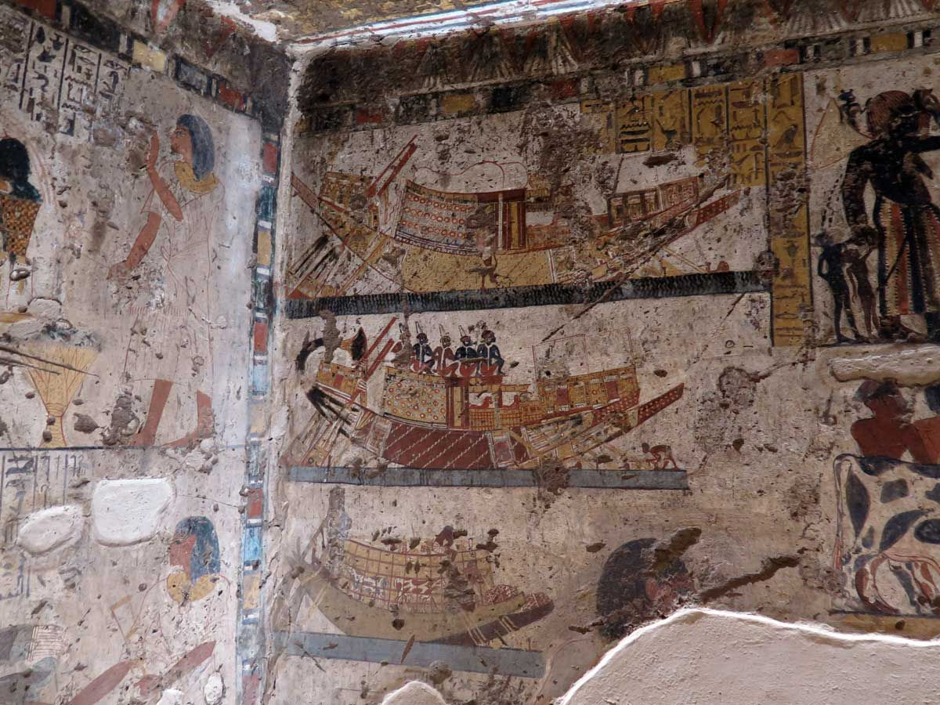
BURIAL CHAMBER OF AMENHOTEP I.
TEMPLE OF AMENHOTEP I,
ONE OF THE OLDEST TEMPLE IN KARNACK.

Slide 26
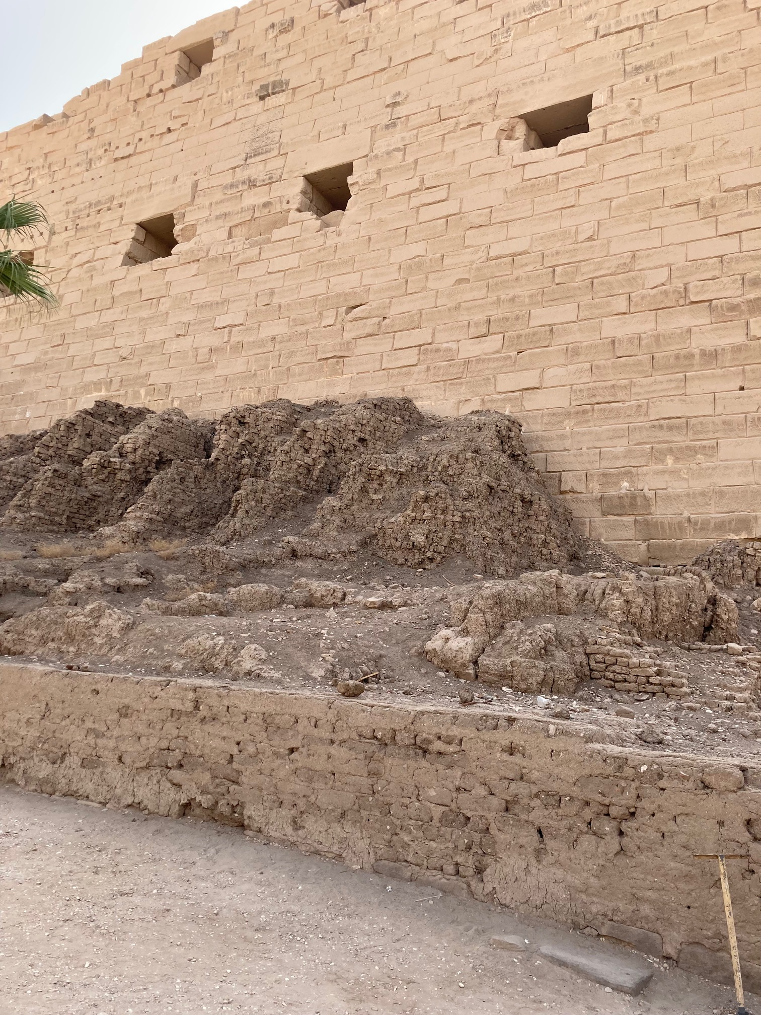
Amenhotep, the son of Ahmose, was the ruler who rebuilt and expanded the Valley of the Kings. With ambitious building projects of his father and for himself, is it possible that the Hebrews were used in part to help rebuild the palaces, temples, and the Temple of Karnack.
The Israelites were enslaved to make straw bricks. At Karnack Temple, there is an example of how straw bricks were used to build the walls of the Temples. These were not removed.

Slide 27
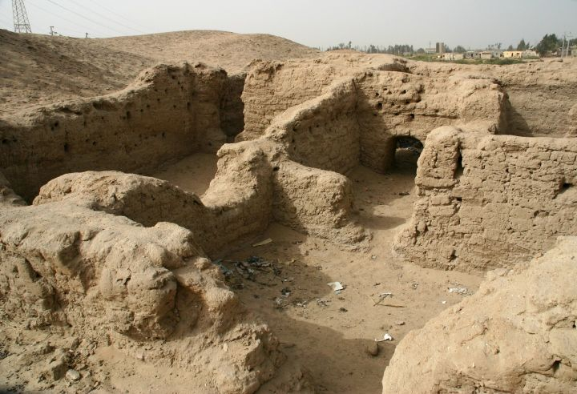
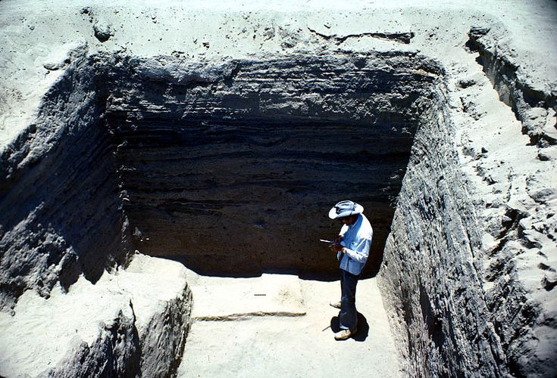
PICTURES OF ARCHAEOLOGICAL SITE OF PITHOM
Pithom appears to be more of a storage city than a “treasure city” for the army and food supply.

Slide 28
B3. THE RELEVANCE TO THE EXODUS.
If during the reign of Ahmose and Amenhotep, the pharaohs were repairing the old temples, building new temples as well as developing their agricultural and livestock. They needed workers.
The biblical text states this, “They made their lives bitter with harsh labor in brick and mortar and with all kinds of work in the fields; in all their harsh labor the Egyptians worked them ruthlessly” (Exod. 1:14).
Archaeologists believed that they have found Pithom with its thick brick walls and “storage buildings” without windows.
Question: The site is almost confirmed, but the names of Pithom and
Rameses have been attributed to Rameses II.

Slide 29
THE MENTIONING OF STORAGE CITY RAMESES
The Biblical text mentions Pithom and Rameses that the Hebrews built as storehouses during the enslavement. The question then becomes this: Who is the Rameses referring to in the Biblical text?”
The Options:
A. Commonly accepted as Rameses II, Pharaoh of Egypt.
Uncommonly known that Rameses’ name is a common name for
royal court of Egypt.

Slide 30
NAMES OF THE CHILDREN OF AHMOSE I.
AMENHOTEP I – SON AHMOSE-MERITAMUN - DAUGHTER
AHMOSE-ANKH - SON MUTNOFRET - DAUGHTER
SIAMUN - SON AHMOSE SITAMUN - DAUGHTER
RAMOSE - SON
It is important to note that Ramose/Ramesses was a prince of Ahmose I and younger brother to Amenhotep I. Ramose (Egyptian: rꜥ-ms(.w) means "Ra is born". Variants of the name include Ramesses (Ramessu) and Paramessu. Some scholars write it as Kamose.
Could it be that Amenhotep I built the cities and name one of them after his brother, Ramose in honor of him?

Slide 31
TWO FOUNDATIONAL ASSUMPTION AND QUESTIONS:
IF Ahmose I is the pharaoh that enslaved the Hebrews, how does he and his lineage intersect with the Biblical narrative and how many pharaohs are viewed in Exodus 1-2?
As one looks at the Egyptian timeline, it appears that more than one pharaoh intersects with the Biblical narrative of Exodus 1-15.

Slide 32
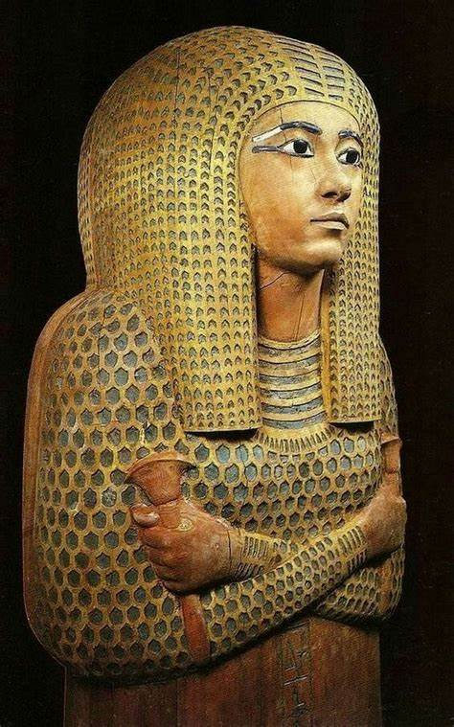
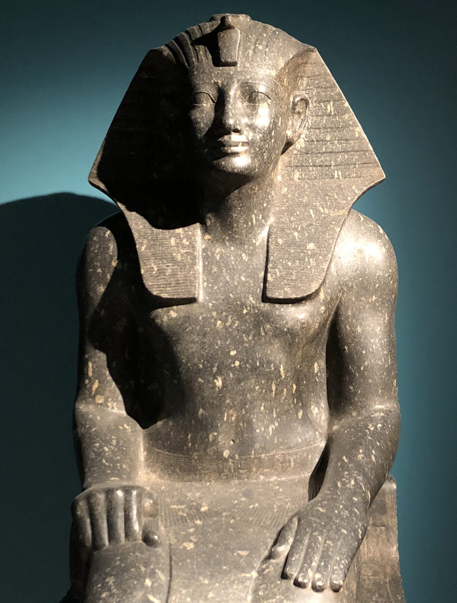
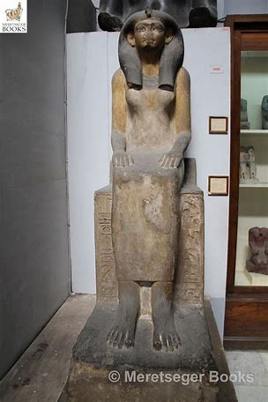
THE LINEAGE OF THUTMOSE I AND HIS WIFE, AHMOSE-MERITAMUN.
THIRD RULER OF THE MIDDLE KINGDOM
OLDER SISTER: THUTMOSE I YOUNGER SISTER:
MERITAMUN MUTNOFRET

Slide 33
THUTMOSE I (ca. 1504-1492).
1. OVERVIEW OF THE LIFE OF THUTMOSE I.
• Thutmose I means “Thorth is born.”
• Thutmose I marries Ahmose Meritamun who had four children:
Amenmoses, Wadjmoses, Hatshepsut, and Nebrufity.
• Thutmose I restores the glory of Egypt by defeating the
Nubian and again the Hyksos threat in Canaan.
• Thutmose I expands the Temple at Karnack.
• Thutmose I marries Mutnofret and has a son.
• Thutmose I appoints Hatshepsut as regent to Thutmose II.
• Thutmose I is buried in the Valley of the Kings.

Slide 34
C2. THE CAMPAIGNS OF THUTMOSE I.
The Nubian revolted against Thutmose whereby he sailed down the Nile to defeat them. He dredged the Nile making it possible to sail from the Delta into Nubia (Sudan). “Year 3, first month of the third season, day 22. His Majesty sailed this canal in victory and in the power of his return from overthrowing the wretched Kush.[18]”
Thutmose I marched his Egyptian army to weaken the Hyksos in Canaan even crossing the Euphrates River where he encountered elephants. He cited this strange phenomenon to him, "that inverted water which flows upstream when it ought to be flowing downstream."[10].
Amenmoses, Commander of the Army, and Wadimoses predeceased before their father dies.

Slide 35
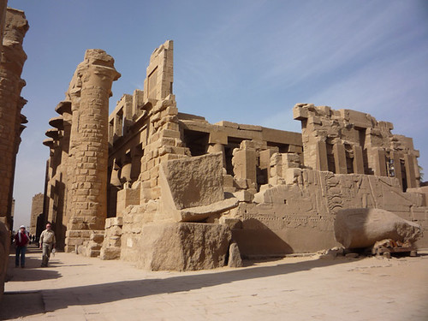
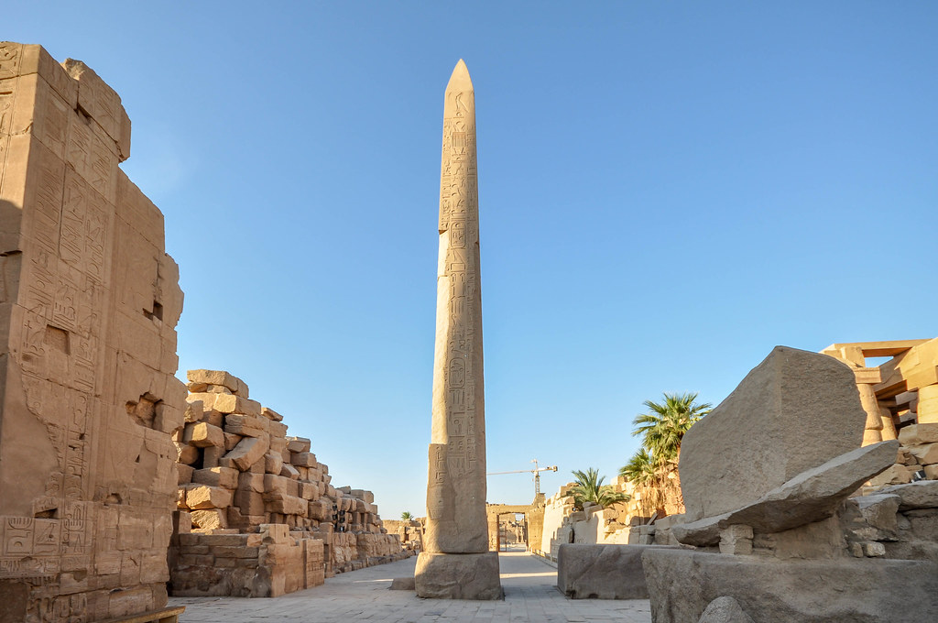
C3. THE CONSTRUCTIONS BY THUTMOSE I.
Thutmose I greatest project was expanding the Temple of Karnack, building temples, wooden columns, and stele.

Slide 36
C4. THE RELEVANCE TO THE EXODUS.
The Biblical narrative states that a princess of Pharaoh adopted a Hebrew baby found among the reeds. Exodus 2 says this, “9 Pharaoh’s daughter said to her, “Take this baby and nurse him for me, and I will pay you.” So the woman took the baby and nursed him. 10 When the child grew older, she took him to Pharaoh’s daughter and he became her son. She named him Moses,[b] saying, “I drew him out of the water.”
Question: Why would Pharaoh’s daughter adopt a Hebrew baby boy to be her son? Is it possible that Thutmose I’s two sons were deceased and he had no male heir during this time period? Later Thutmose I has a son through his second wife: Mutnofret.

Slide 37
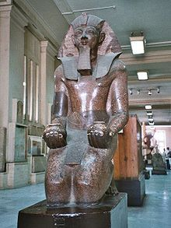
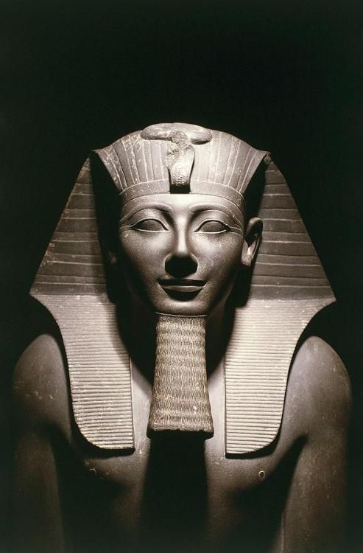
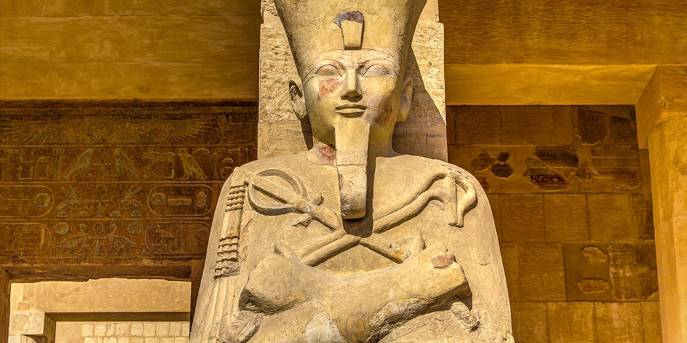
D. THE LINEAGE OF PRINCESS - PHARAOH HATSHEPSUT.
HATSHEPSUT
THUTMOSE II THUTMOSE III

Slide 38
D. THE LINEAGE OF HATSHEPSUT (ca. 1492-1958 BCE).
1. OVERVIEW OF HATSHEPSUT.
• Daughter of Thutmose I
• Thutmose II:
a. Co-regent with Thutmose II who became pharaoh at age 2
b. Thutmose II marries Hatshepsut who has a daughter, Neferure
c. Thutmose II marries Iset who has a son
d. Thutmose II dies at age between 30 (?)
• Thutmose III:
a. Co-regent with Thutmose II as the boy pharaoh at age 7(?)
• Hatshepsut becomes the Queen Pharaoh
• Hatshepsut stabilizes the throne and develops Egypt economically
• Hatshepsut builds her mortuary temple, Temple of Hatshepsut
• Hatshepsut rules as co-regent – Pharaoh: ca 1492-1458 BCE

Slide 39
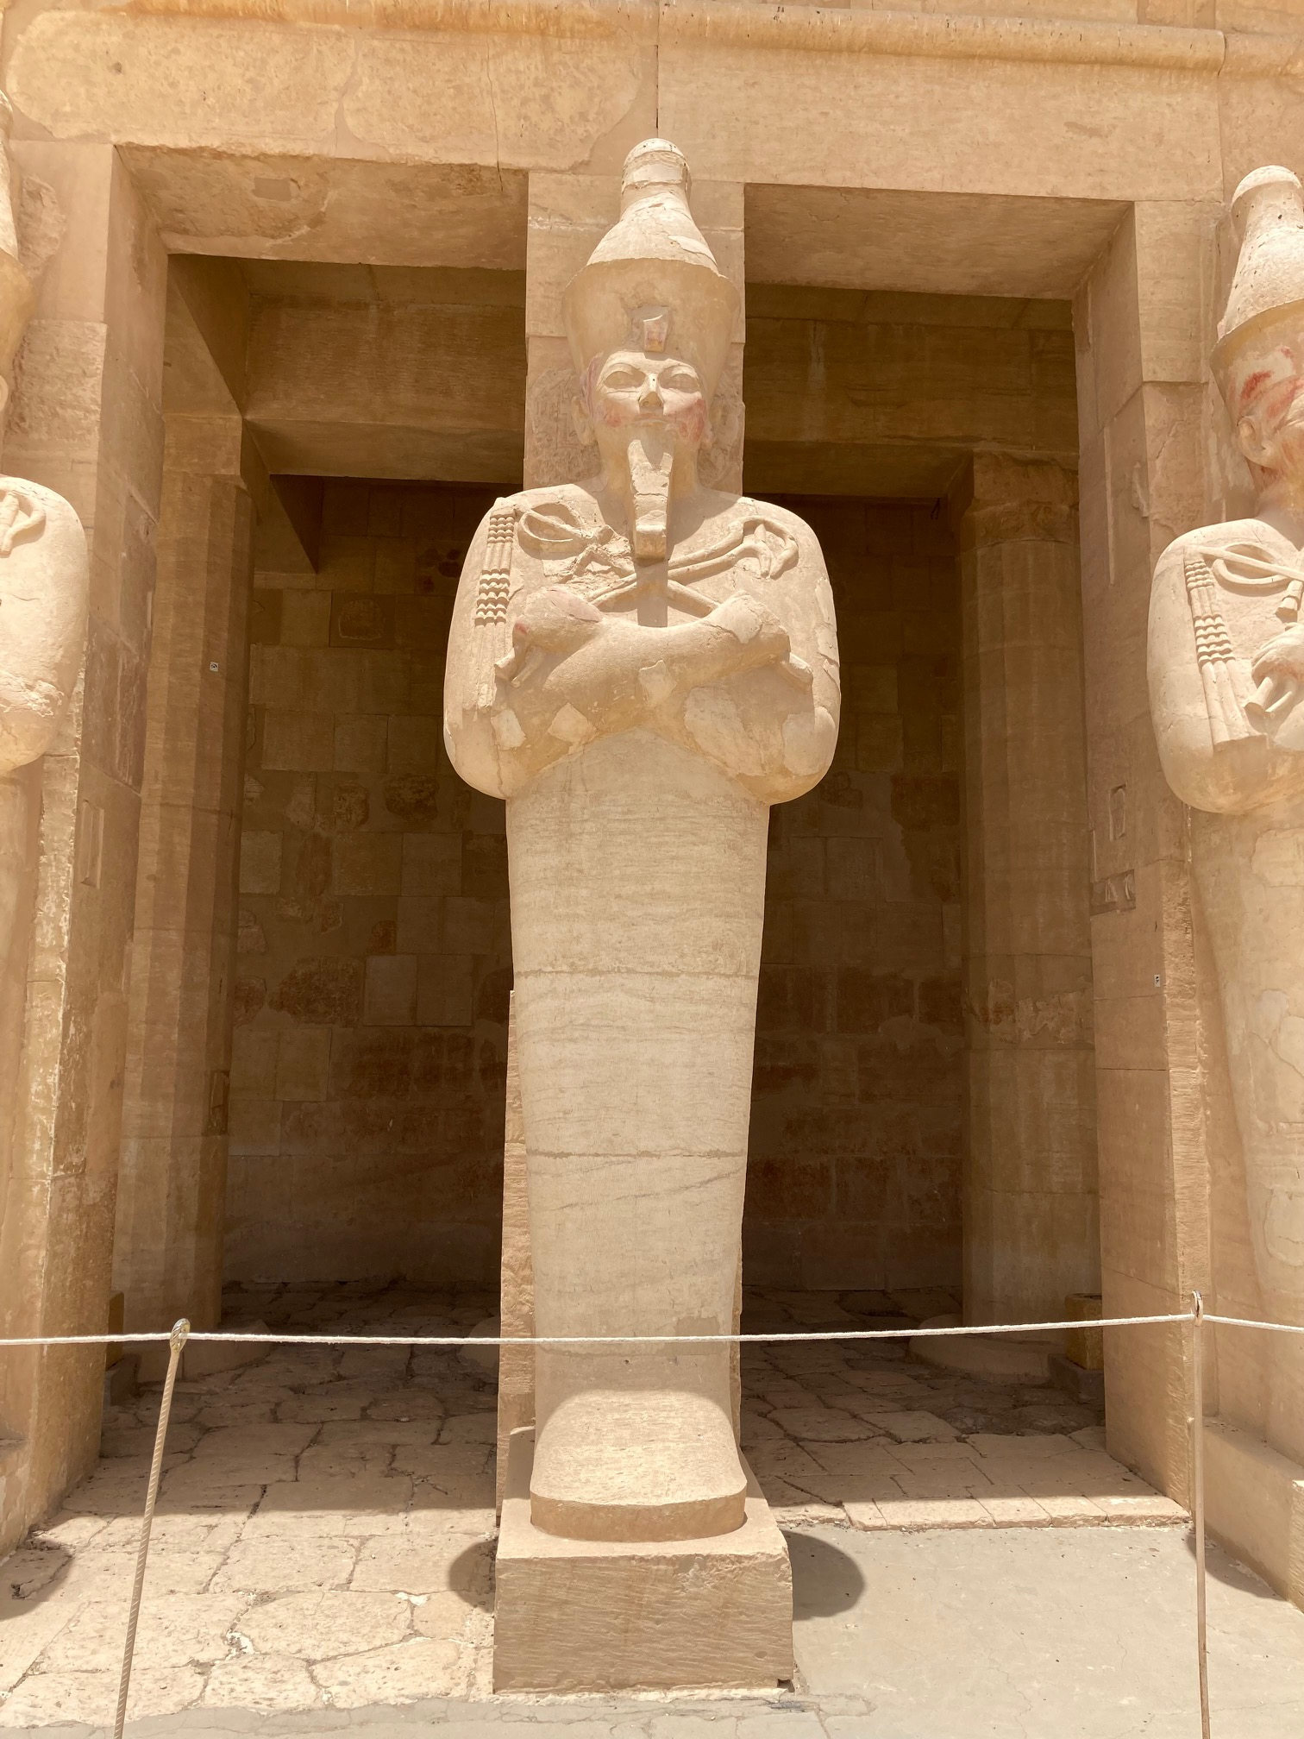
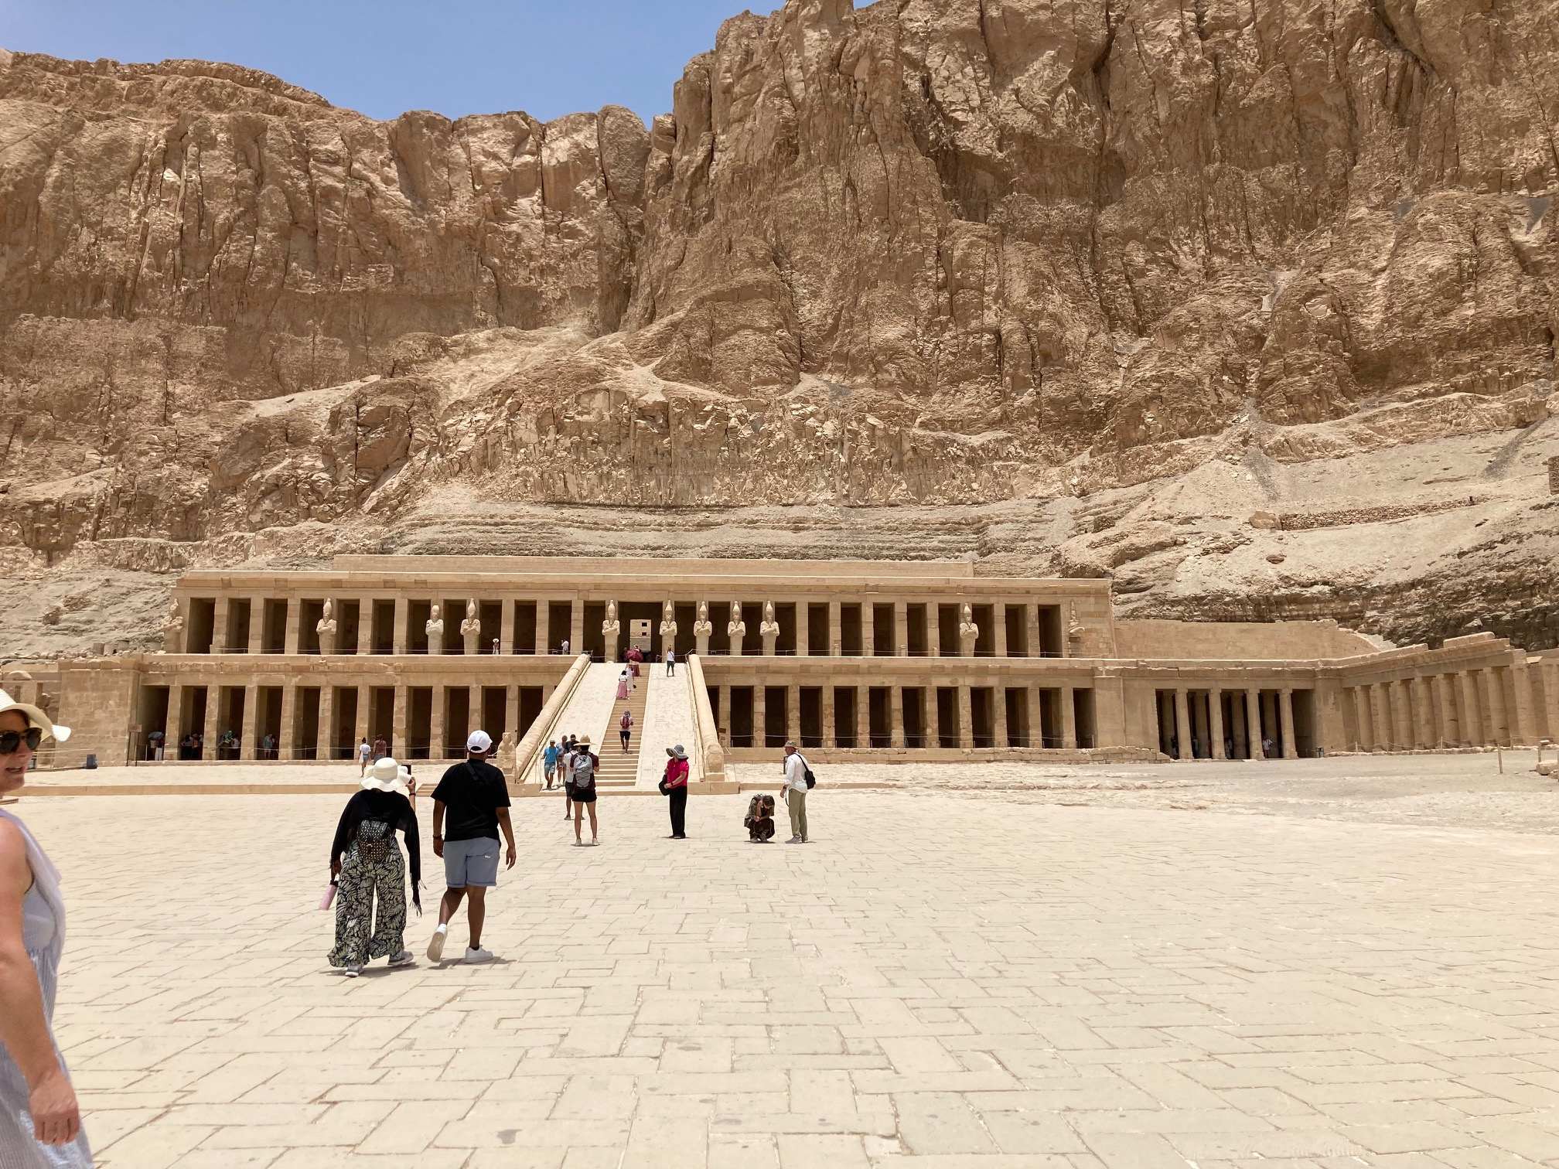
D2. THE MORTUARY TEMPLE OF HATSHEPSUT.

Slide 40
D3. THE RELEVANCE OF HATSHEPSUT TO THE EXODUS.
As one reads about the Thutmose I, parent of Hatshepsut, her siblings predeceases her father. Amenmoses dies in battle and Wadjmoses cause of death is unknown. Her baby sister, Nebrefity dies at a young age. Thutmose has no male heir. It is only later that he marries a second wife and has a son through her.
Could it be that the princess by the Nile River is Hatshepsut who adopts this Hebrew baby found in a basket in the Nile River? If Thutmose I had a son, it is unlikely that this Hebrew baby would be adopted and become part of the royal family.
Moses grows in the Egyptian court for 40 years under the guidance of the princess. When Thutmose I dies, Moses is still in the royal court with a boy Pharaoh. Thutmose II marries Hatshepsut to secure his right to the throne when he is older.

Slide 41
E. THE LINEAGE OF THUTMOSE III (CA. 1470-1425 BCE).
1. OVERVIEW OF THUTMOSE III.
• Son of Thutmose II from a second wife, Iset
• Great Aunt, Hapshepsut co-regent with boy and becomes
rules Egypt while Thutmose III lives in her shadow
• Ascends to the throne after Hatshepsut dies
• Acquires military skills and experiences as military commander
• Becomes a statesman in the latter half of his reign
• Builds temples at Karnack
• Begins to erase the name and images of Hatshepsut
• Buried in the Valley of the Kings

Slide 42
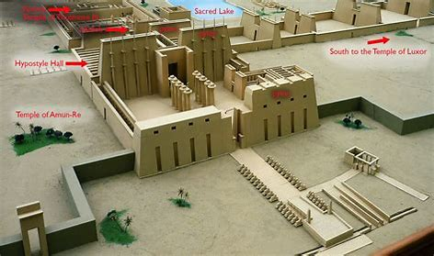
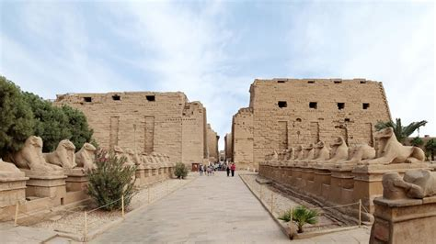
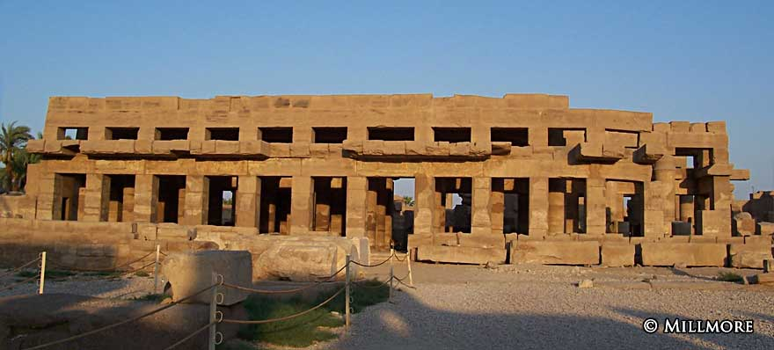
TEMPLE OF AMUN BY THUTMOSE III

Slide 43
E2. THE MILITARY CAMPAIGNS OF THUTMOSE III.
It is likely that Thutmose III engaged in a smaller campaign against the Canaanites under Hatshepsut. Upon his ascension, the kingdoms of the Canaanites and the kingdom of Mittani across the Euphrates River form an alliance to attack Egypt. At Megiddo, Thuthose III surprised them by entering a small narrow passage and defeated them. Thutmose rulee from Canaan across the Euphrates River.
To the south, he subdue the Nubia to gain their gold and trade. Thutmose III had expanded the rule of Egypt, conquering the known world during his time. He was the most powerful ruler of the world. Wealth poured into Egypt during the latter reign of Thutmose III.

Slide 44
E3. THE RELEVANCE OF THUTMOSE III TO THE EXODUS.
a. The Military Prowess of Thutmose III.
The historical background of Thutmose III shows that he was a mighty warrior defeating all other warriors. He defeated all the other gods of the Nubian, Canaanites, and the Mittani. He was the greatest warrior pharaoh of his time. No one dared to oppose Thutmose III.
Could it be that after Thutmose III’s victories led him to say to Moses, “2 Pharaoh said, “Who is the LORD, that I should obey him and let Israel go? I do not know the LORD and I will not let Israel go”?
Thutmose had defeated all the other deities that he conquered. He had disdain and disrespect for the God of Moses who doesn’t have an army to compel him to let the Hebrews go and worship the LORD.

Slide 45
E3b. The Death of Thutmose III firstborn son.
Thutmose III, firstborn son, Amenemhat was born to him from his wife, Satiah. He was the crowned prince with the title, “prince of cow.” The cause of his death is unknown, but his tomb is in the Valley of the Kings.
It is unlikely that Amenemhat was a baby/boy prince but a man since Thutmose III reign between the 24 and 33 year of his reign. Thutmose III had 9 children through other wives. It doesn’t appear that Amenemhat died in one of Thutmose’s military campaign.
Did the Angel of Death strike down Thutmose III’s firstborn son?

Slide 46
E3c. The Wealth of Thutmose III.
With Thutmose III conquering and receiving tributes from foreign countries and rulers, Egypt was wealthy. In the 9 plagues, Egypt experienced a temporary loss of livestock and agriculture. Egypt still had her wealth of gold and trade with the Hebrews doing their work.
With the death of the 10 plague, Egypt loss its slaves and its riches. Could it be true that as God promised the descendants of Abraham that the will leave the land with riches and did under Thutmose III?

Slide 47
PICTURE AND TOMB OF THUTMOSE III.

Slide 48
E3d. The Diminish Military Might of Egypt.
Egypt suffered the loss of their firstborn sons and were grieving in burial of them. With Pharaoh commanding his army to pursue and capture the Hebrew slaves, they entered the departed Reed Sea. The Biblical record states that the army and chariots drowned. They suffered a military disaster with the loss of chariots and men.
Historical records states that Amenhotep II became pharaoh after his father’s death. This gave time for Egypt to raise up another generation of soldiers. Amenhotep II made incursion into Canaan, possibly to replace the loss slaves. He was a weaken pharaoh compared to his father, Thutmose III.
Is Amenhotep II the surviving son of the 10th plague or as some scholars suggest that he may be the pharaoh that Moses confronted?

Slide 49
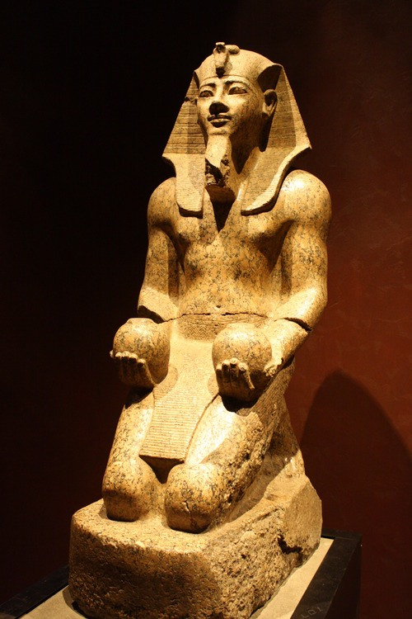
PICTURE OF AMENHOTEP II AND HIS BURIAL TOMB FROM THE VALLEY OF THE KINGS.

Slide 50
SUMMARY:
There is debate on who is the pharaoh that Moses faced whether the lineage of Ahmose I or the lineage of Ramses. There are pros and cons for both viewpoint.
God promised to Abraham his descendants will be a great people group, living in a foreign land, being enslaved, leaving with the riches of that land, and returning to the Promised Land.
Exodus 1-15 records how God fulfilled his promise to Abraham and to his descendants. Looking at the Egyptian history, I suggest that the Exodus 1-2 account takes places during the reign of Ahmose I and his sons.

Slide 51
ACKNOWLEDGEMENTS:
The information and references on the pharaohs are based on the reading on the internet. The compilation of information comes from several sources that includes the following:
Ancient Egypt Info
Biblical Archaeology
The Encyclopedia Britannica
History.Com
World History
Photos from online from Microsoft on the Pharaohs

